Slide 1

The Gamma-400 space experiment
Valter Bonvicini
INFN – Trieste, Italy
On behalf of the Gamma-400 Collaboration
Neutrino Oscillation Workshop - NOW 2012
Conca Specchiulla (Otranto, Lecce, Italy) – September 9 – 16, 2012

Slide 2
Outline
Introduction
Gamma-400 mission:
  “Baseline” (original Russian) project
  Italian proposal
Gamma-400 physics potential
  Photons
  Electrons
  Nuclei
Conclusions

Slide 3
Gamma-400 Collaboration
Lebedev Physical Institute (leading organization)
National Research Nuclear University MEPhI
Ioffe Physical Technical Institute
Open Join Stock Company “Research Institute for Electromechanics” (Istra)
Institute for High Energy Physics (Protvino)
Space Research Institute
Istituto Nazionale di Fisica Nucleare (INFN), Italy
Istituto Nazionale di Astrofisica, INAF, Italy
NASA Goddard SFC/University of Maryland, USA
Kavli Institute/Stanford University, USA

Slide 4
The Gamma-400 project
Mission is approved by ROSCOSMOS (launch currently scheduled by November 2018)
Gamma-400:
  Scientific payload mass: 2600 kg
  Power budget: 2000 W
  Telemetry downlink capability: 100 GB/day
  Lifetime: 10 years
  Orbit (initial parameters): apogee 300000 km, perigee 500 km, orbital period 7 days, inclination 51.8 °
  Gamma-400 will be installed onboard the platform “Navigator” manufactured by Lavochkin

Slide 5
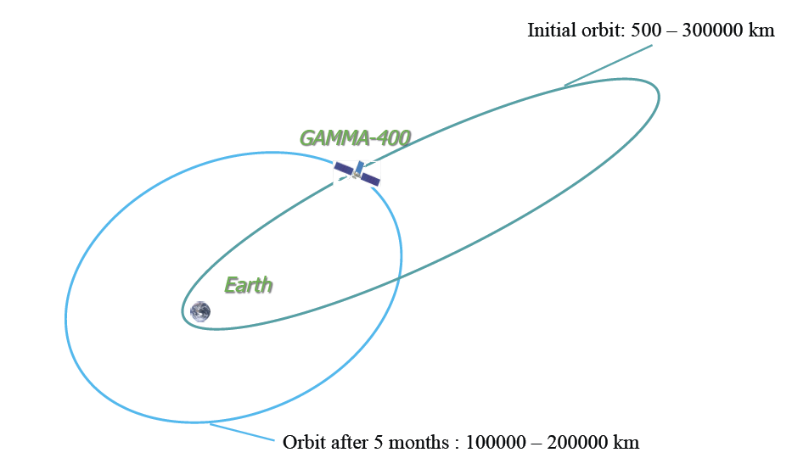
Gamma-400 orbit

Slide 6
Gamma-400 “baseline”
Original Russian design focused on:
  High energy gamma-rays (10 GeV - 3 TeV)
  High energy electrons (e⁻ and e⁺)
Science objectives (from Russian proposal):
  “To study the nature and features of weakly interacting massive particles, from which the dark matter consists”
  “To study the nature and features of variable gamma-ray activity of astrophysical objects from stars to galactic clusters”
  “To study the mechanisms of generation, acceleration, propagation, and interaction of cosmic rays in galactic and intergalactic spaces”

Slide 7
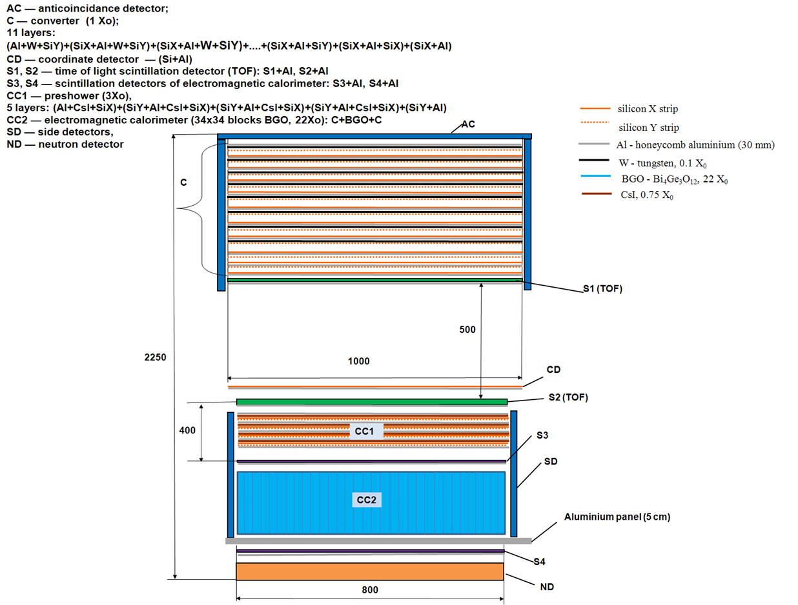
Gamma-400 “baseline”
Gamma-ray energy range | 10 – 3000 GeV
Multilayer converter | Si-W, 11 layers, 100 x 100 cm² , 0.84 X₀
Calorimeter CC1 | CsI-Si, 5 layers, 80 x 80 cm², 3 X₀
Calorimeter CC2 | 1024 BGO bars (25 x25 x 250 mm³), 80 x 80 cm², 22 X₀
Angular resolution (@ 100 GeV) | 0.01 – 0.02°
Energy resolution (@ 100 GeV) | 1 – 2%
Proton rejection | ∼10⁵

Slide 8
Gamma-400: Italian proposal
Availability for a revision of the design that could enhance the performance and science capability of the project
Gamma-400: a multi-purpose mission (photons@ high- and low-energies, electrons, nuclei)
Revised design of the converter/tracker
  Breakthrough angular resolution (4-5 times better than Fermi-LAT @ 1 GeV)
  Improved sensitivity
Homogeneous and isotropic calorimeter (∼ 40 X₀ and 2 λ_{I}) with optimal energy resolution and particle discrimination
  Electron/positron detection beyond TeV energies
  Nuclei detection up to 10¹⁵ eV (“knee”)
Nuclei identification capability (dE/dx measurement) with Silicon pad detectors
Trigger with TOF capabilities (“smart” AC)

Slide 9
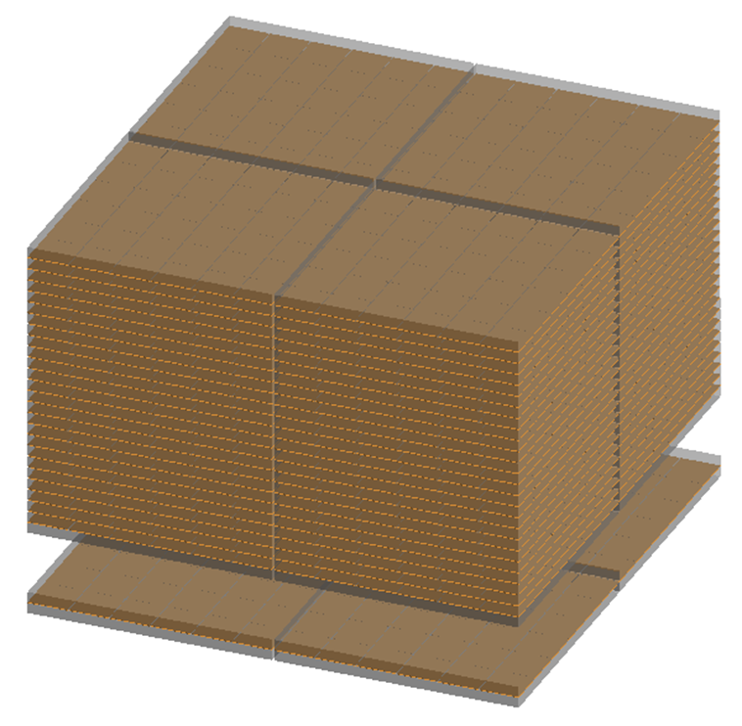
Converter/Tracker
Homogeneous Si-W Tracker
25 W/Si-x/Si-y planes
Thickness of each plane 0.03X₀
4 towers (∼ 50 cm x 50 cm each)
Single-sided, ∼ 120 µm pitch
microstrip detectors
Each sensor ∼ 9.7 cm x 9.7 cm
Sensors arranged in ladders (5
detectors/ladder)
Capacitive charge division readout
(1 strip every 2)
5000 silicon detectors
384000 readout channels

Slide 10
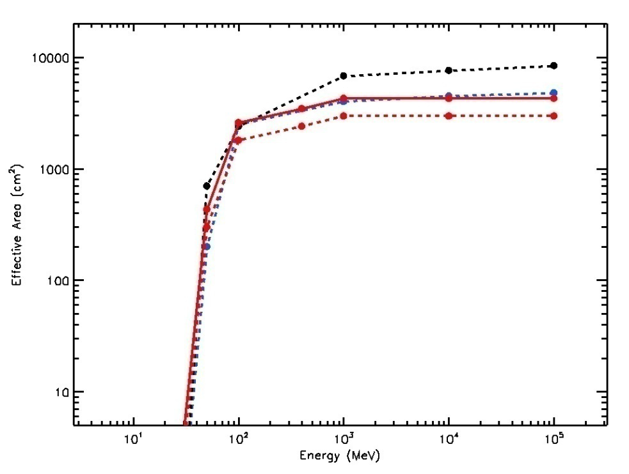
Gamma-400 and Fermi: A_{eff} & PSF
Effective area
PSF
Black line: Fermi front+back
Blue line: Fermi front
Red solid line: G-400 120 x 120 cm²
Red dashed line: G400 100 x 100 cm²
Black line: Fermi front
Blue line: Fermi front + back
Red line: Gamma-400

Slide 11
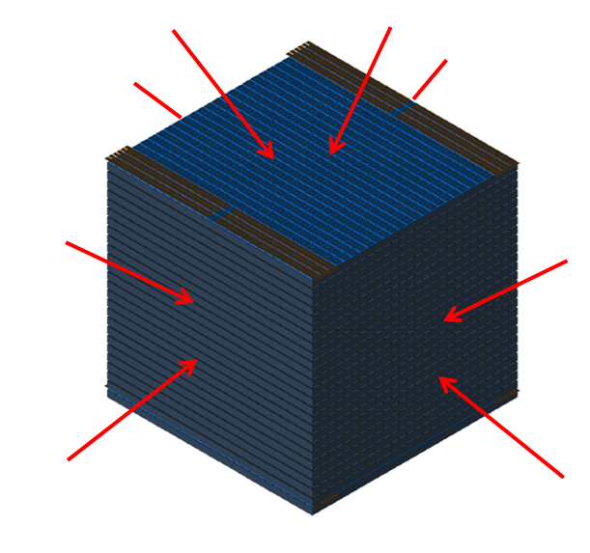
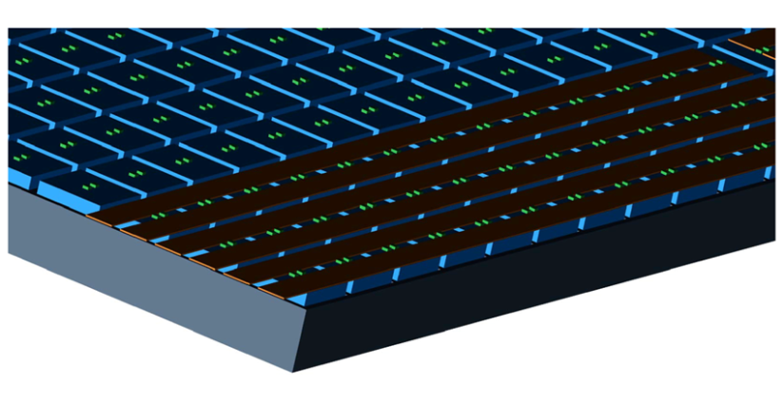
Calorimeter
Homogeneous cubic calorimeter
Symmetric, to maximize GF
Total mass < 1600 kg
Very large dynamic range
Finely segmented in all directions
microstrip detectors
1 R_{M} x 1 R_{M} x 1 R_{M} CsI(Tl) cubic
crystals
Few mm gaps between crystals
Detail of a calorimeter plane:
Blue: crystals
Grey: Al support
Green: photodetectors
Brown: readout cables

Slide 12
Calorimeter details
 | Cubes | Cubes | Cubes | Cubes
N×N×N | 20×20×20 | 20×20×19 | 21×21×18 | 32×32×32
L (cm) | 3.6* | 3.6* | 3.6* | 2.2
Crystal volume (cm³) | 46.7 | 46.7 | 46.7 | 10.6
Gap (cm) | 0.3 | 0.4 | 0.3 | 0.3
Mass (Kg) | 1683 | 1599 | 1578 | 1574
N.Crystals | 8000 | 7600 | 7497 | 32768
Size (cm³) | 78.0×78.0×78.0 | 80.0×80.0×76.0 | 81.9×81.9×81.9 | 80.0×80.0×80.0
Depth (R.L.) “ (I.L.) | 39×39×39 1.8×1.8×1.8 | 39×39×37 1.8×1.8×1.7 | 41×41×33 1.9×1.9×1.6 | 38×38×38 1.8×1.8×1.8
Planar GF (m²sr) (fiducial**) | 1.72×1.72×1.72 | 1.81×1.72×1.72 | 1.91×1.53×1.53 | 1.89×1.89×1.89
(* one Moliere radius)
(** within a reduced perimeter of size (N-1)*L )

Slide 13
Gamma-400: scientific goals
Dark matter studies at GeV energies, resolving the Galactic Center and providing excellent sensitivity for searches in spheroidal galaxies (several times better than Fermi-LAT)
Cosmic-ray acceleration in SNR and galactic diffusion resolved with unprecedented detail in both space and spectra.
  Excellent sensitivity to neutral pion emission below 200 MeV.

Slide 14
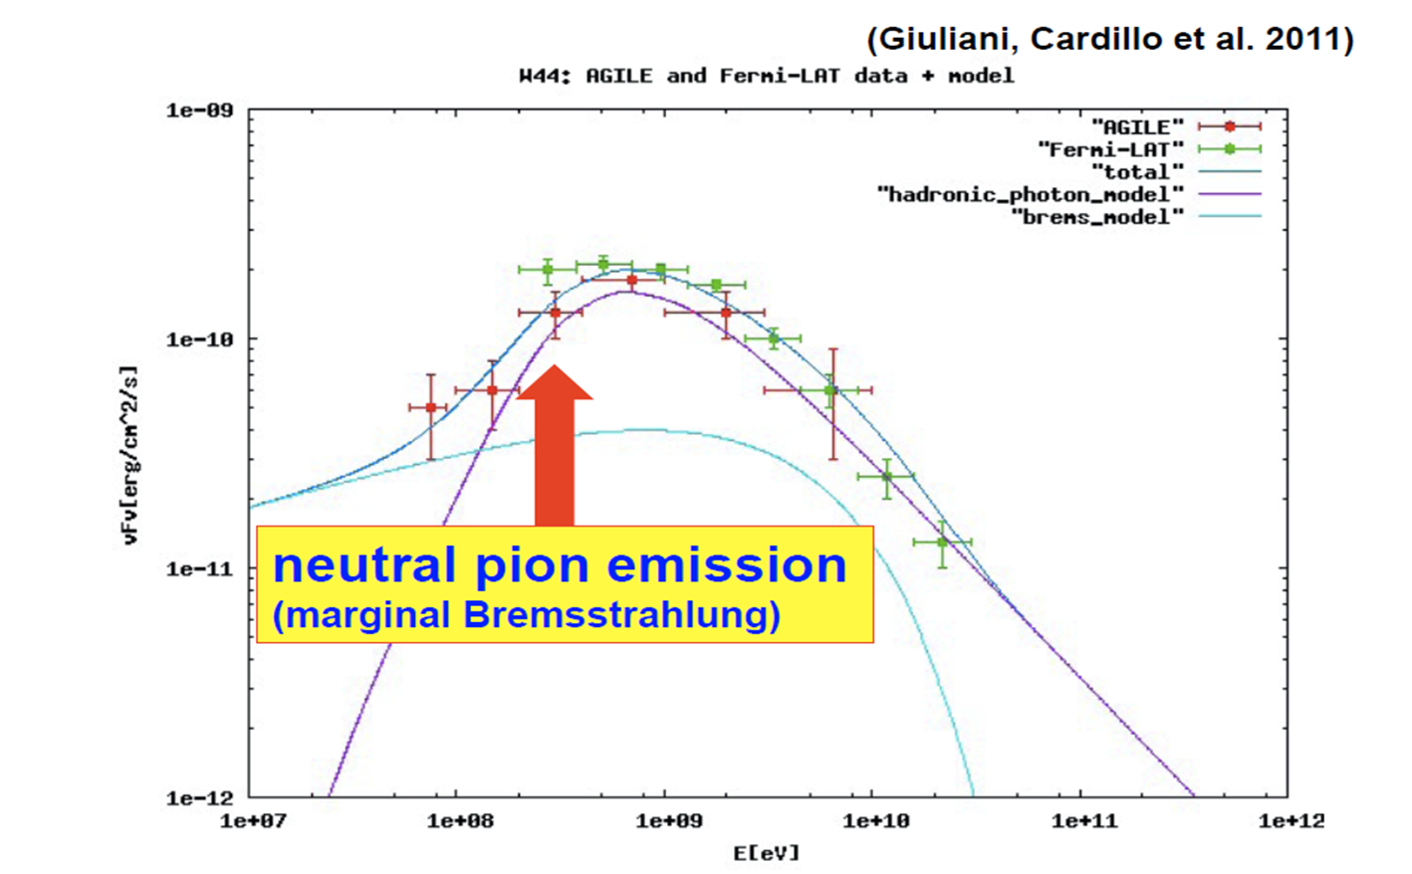
Scientific goals: low-energy γs
Cosmic rays and low-energy γs

Slide 15
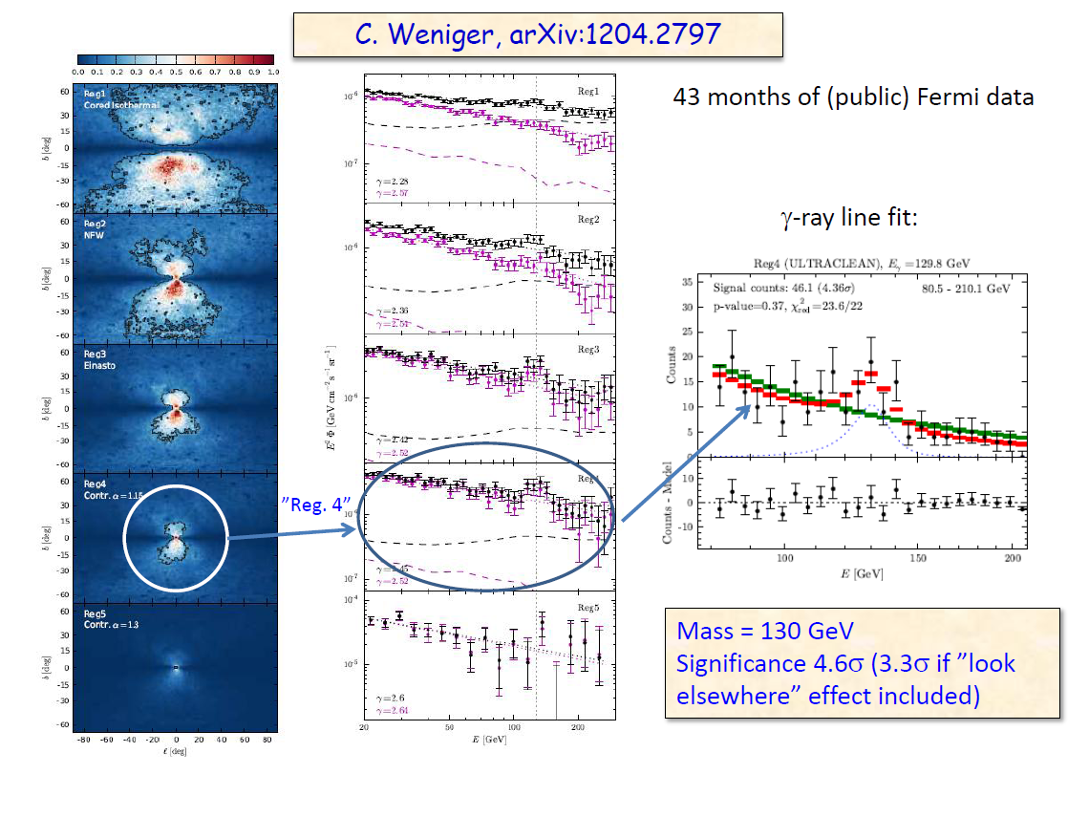
Scientific goals: high-energy γs
+
arXiv:1205.1045
arXiv:1206.1616
Gamma-400 ideal for looking for spectral DM-induced
features, like searching for γ–ray lines! If Weniger is right, the 130 GeV line should be seen with ∼10 σ significance (L. Bergström et al., arXiv:1207.6773v1 [hep-ph])
L. Bergström, , Stockholm 2012

Slide 16
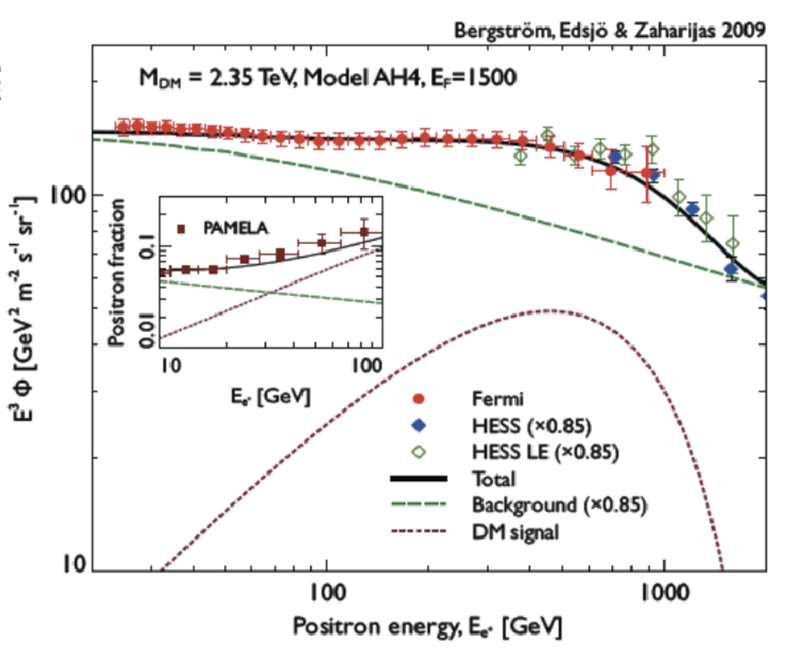
Scientific goals: electrons

Slide 17
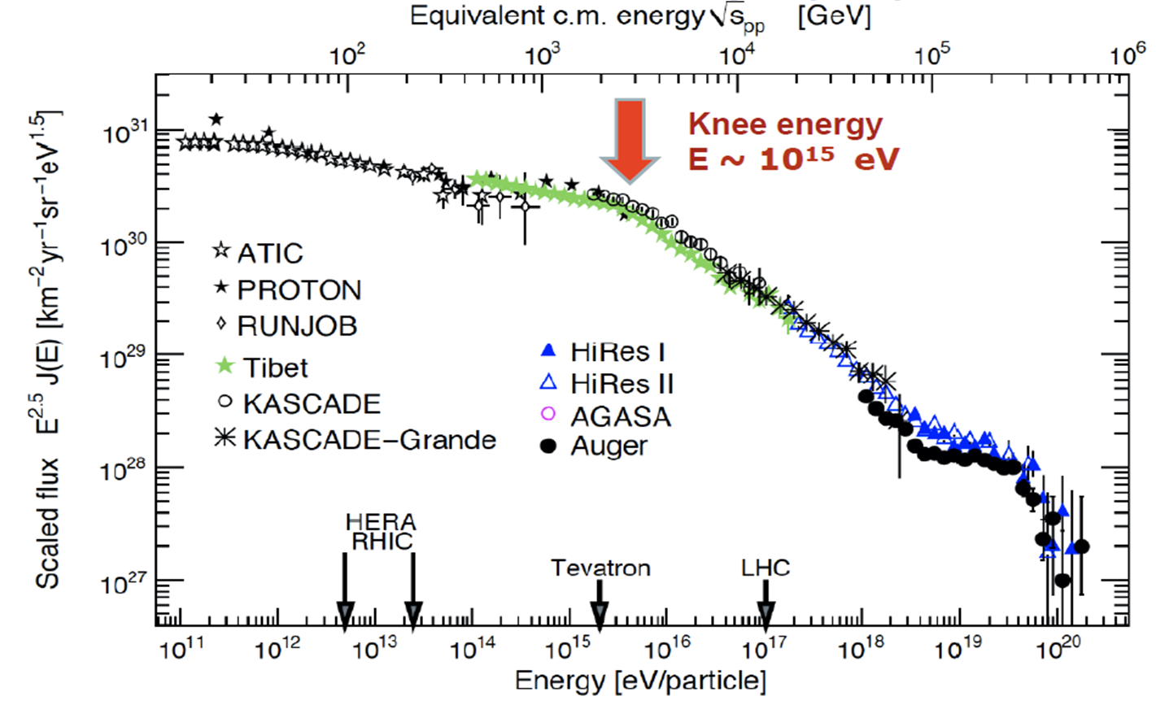
Scientific goals: nuclei

Slide 18
Conclusions
The Gamma-400 mission represents a unique opportunity to perform simultaneous measurements of photons, electrons and nuclei with unprecedented accuracy.
Gamma-400 can provide in-depth investigations on some of the most challenging physics items, such as DM search, CR origin, production and acceleration to the highest energies…
A TDR of the upgraded version of the instrument will be presented by mid 2013.
The launch is currently scheduled by November 2018.

Slide 19
Back-up slides

Slide 20
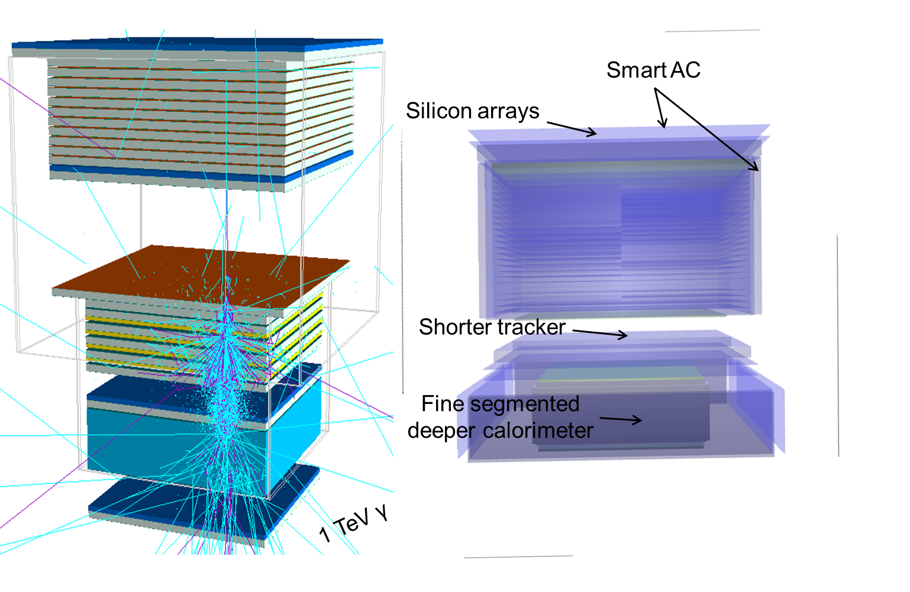
Russian vs. Italian design

Slide 21
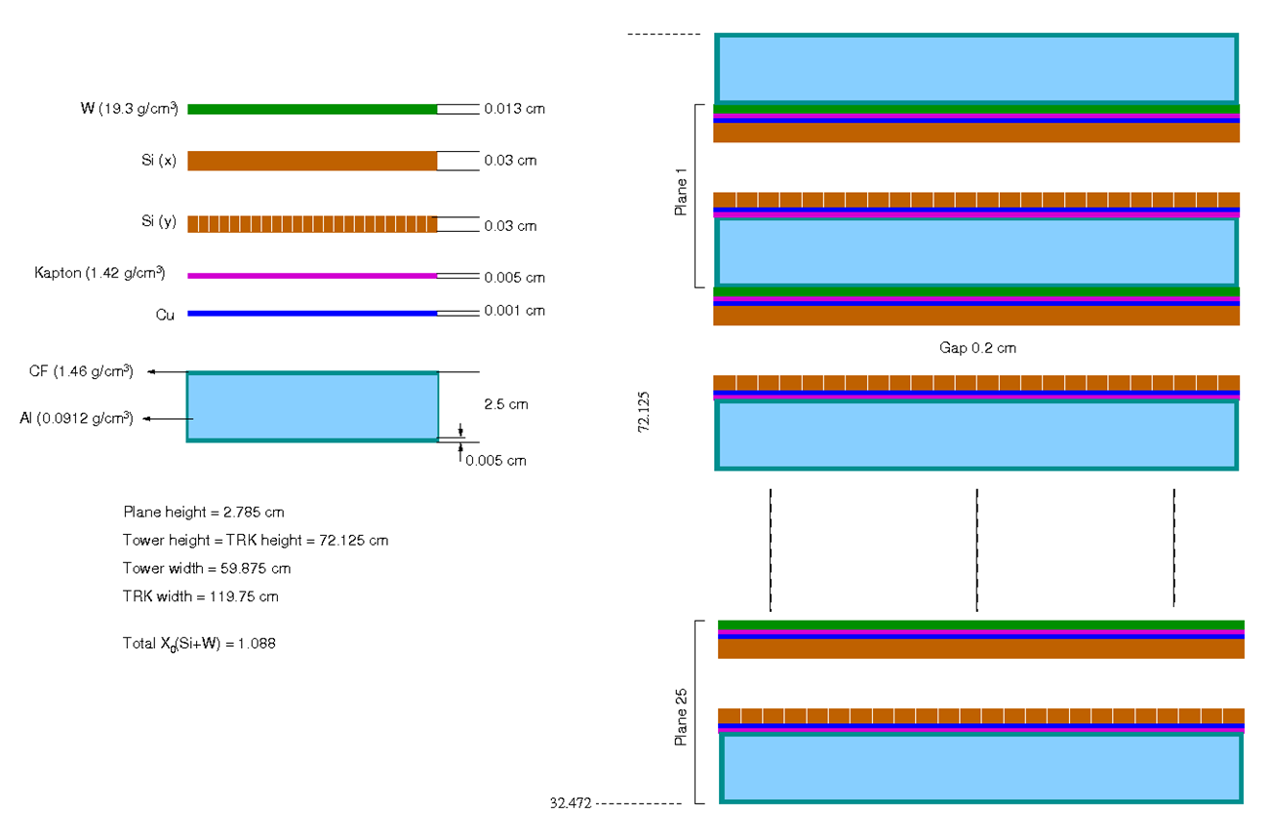
Tracker geometry

Slide 22
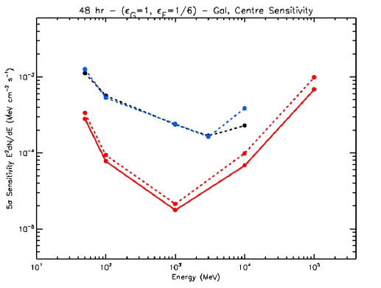
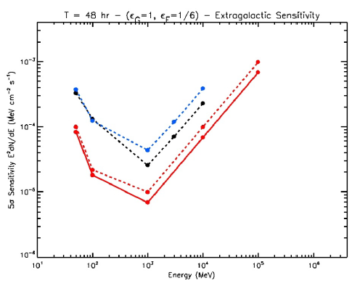
Sensitivity – 48 hrs
Galactic center
Extragalactic
Black line: Fermi front+back
Blue line: Fermi front
Red solid line: G-400 120 x 120 cm²
Red dashed line: G400 100 x 100 cm²

Slide 23
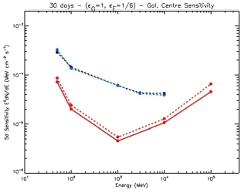
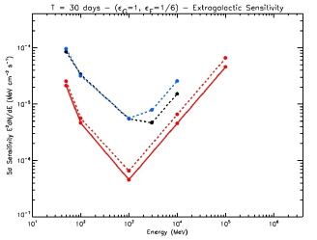
Sensitivity – 1 month
Galactic center
Extragalactic
Black line: Fermi front+back
Blue line: Fermi front
Red solid line: G-400 120 x 120 cm²
Red dashed line: G400 100 x 100 cm²

Slide 24
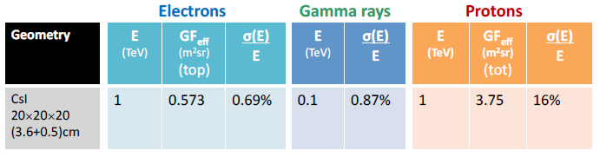
Calorimeter summary

Slide 25
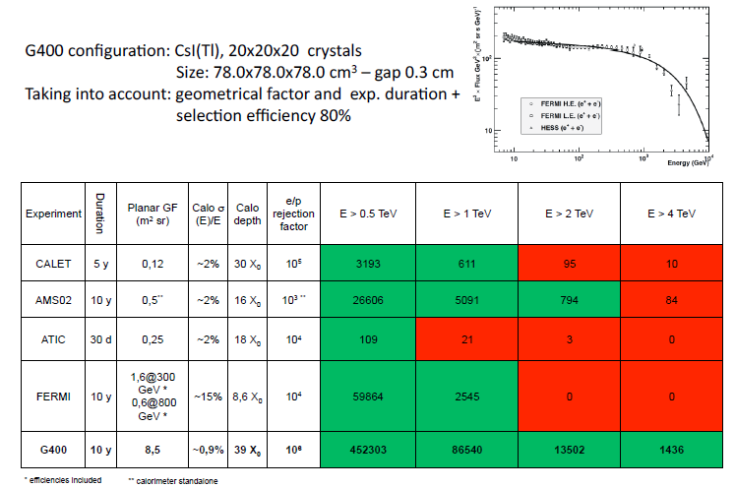
Electrons – counts estimation

Slide 26
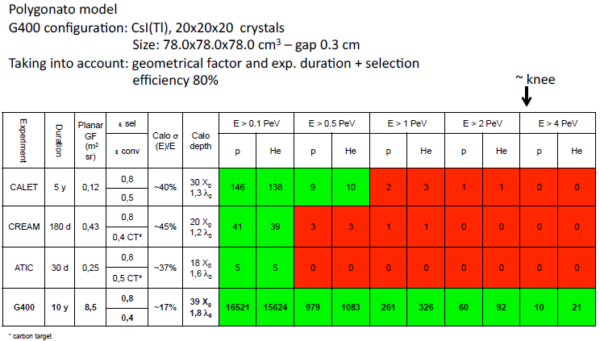
Protons and He – counts estimation

