Slide 1

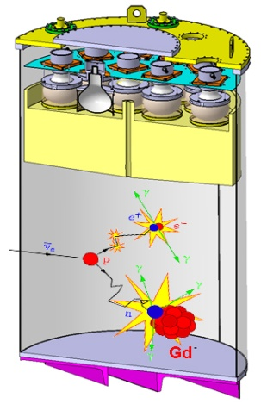

Searching for sterile neutrinos with reactor experiments
Jonathan Gaffiot, Ph.D.
CEA Saclay: IRFU – Service de Physique Nucléaire
Nucifer project - STEREO project

Slide 2
Reactor Antineutrino Anomaly

Slide 3
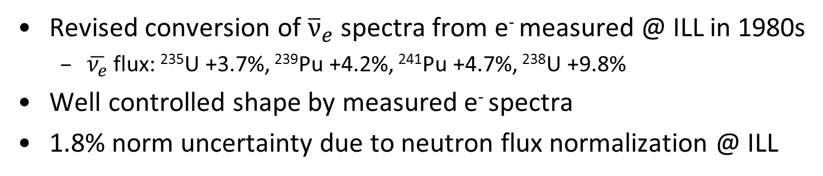
Neutrino spectra
Revised conversion of ${\overline{ν}}_{e}$ spectra from e⁻ measured @ ILL in 1980s
  $\overline{ν_{e}}$ flux: ²³⁵U +3.7%, ²³⁹Pu +4.2%, ²⁴¹Pu +4.7%, ²³⁸U +9.8%
Well controlled shape by measured e⁻ spectra
1.8% norm uncertainty due to neutron flux normalization @ ILL
Uranium 235

Slide 4
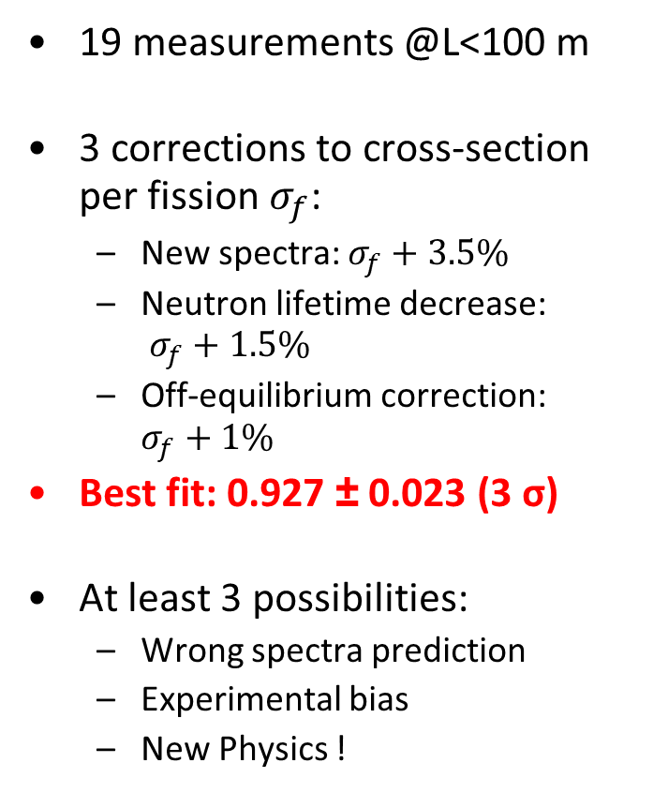
Reactor Antineutrino Anomaly
19 measurements @L<100 m
3 corrections to cross-section per fission $σ_{f}$:
  New spectra: $σ_{f}+3.5\%$
  Neutron lifetime decrease:
  $σ_{f}+1.5\%$
  Off-equilibrium correction: $σ_{f}+1\%$
Best fit: 0.927 ± 0.023 (3 σ)
At least 3 possibilities:
  Wrong spectra prediction
  Experimental bias
  New Physics !

Slide 5
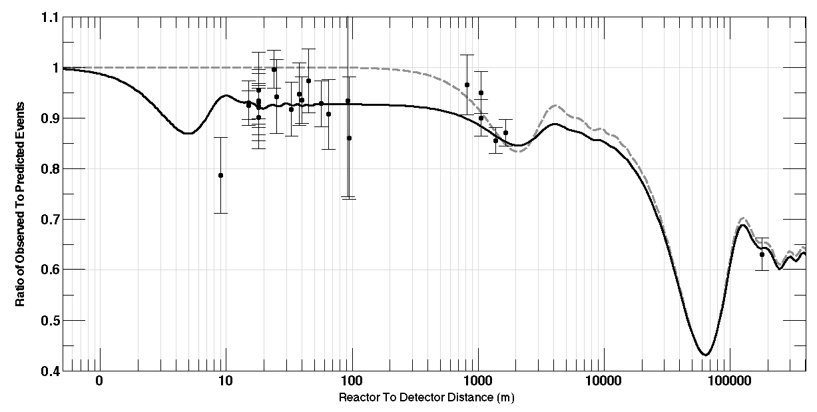
4th neutrino hypothesis
Disparition of neutrinos: new oscillation ?
New oscillation to sterile ν?
Atmospheric oscillation
Solar
oscillation
G. Mention et al., Phys. Rev. D 83, 073006 (2011)

Slide 6
Anomaly contours
Reactor norm + reactor shape + gallium
Reactor norm + shape (Bugey3 15m/40m)
Reactor norm only

Slide 7
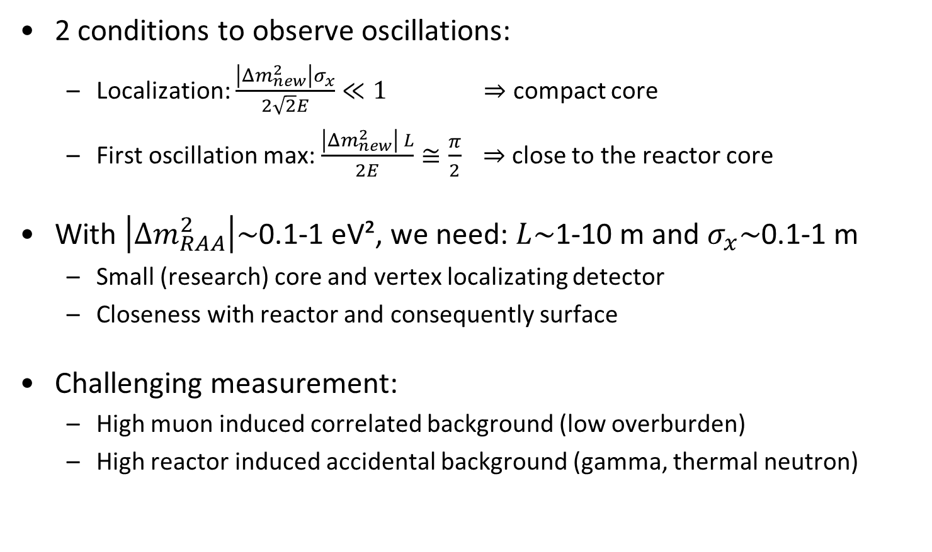
Detector specifications and challenges
2 conditions to observe oscillations:
  Localization: $\frac{\left|Δm_{new}^{2}\right|σ_{x}}{2\sqrt{2}E}≪1 \underset{⇒}{}$ compact core
  First oscillation max: $\frac{\left|Δm_{new}^{2}\right| L}{2E}≅\frac{π}{2} \underset{⇒}{}$ close to the reactor core
With $\left|Δm_{RAA}^{2}\right|\sim$0.1-1 eV², we need: $L\sim$1-10 m and $σ_{x}\sim$0.1-1 m
  Small (research) core and vertex localizating detector
  Closeness with reactor and consequently surface
Challenging measurement:
  High muon induced correlated background (low overburden)
  High reactor induced accidental background (gamma, thermal neutron)

Slide 8
ON going projectS
Nucifer
DANSS

Slide 9
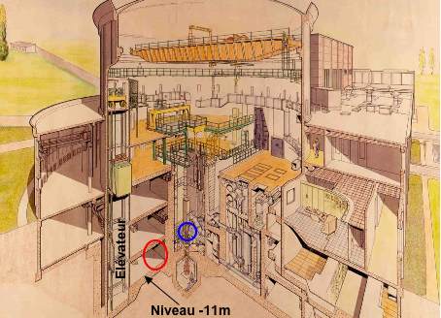
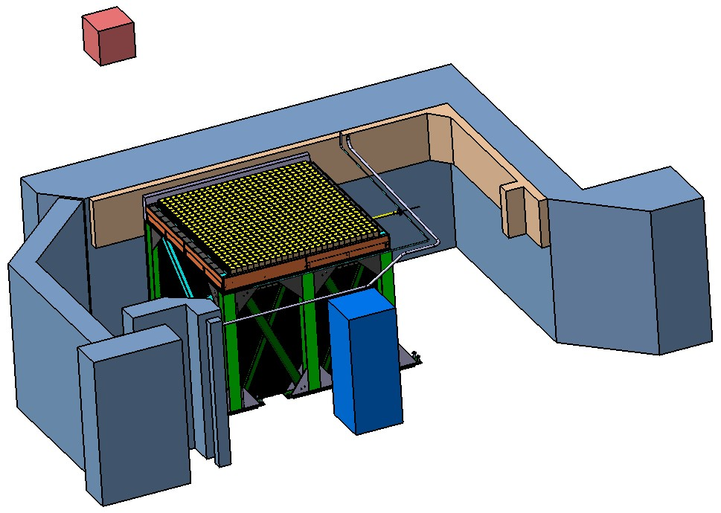
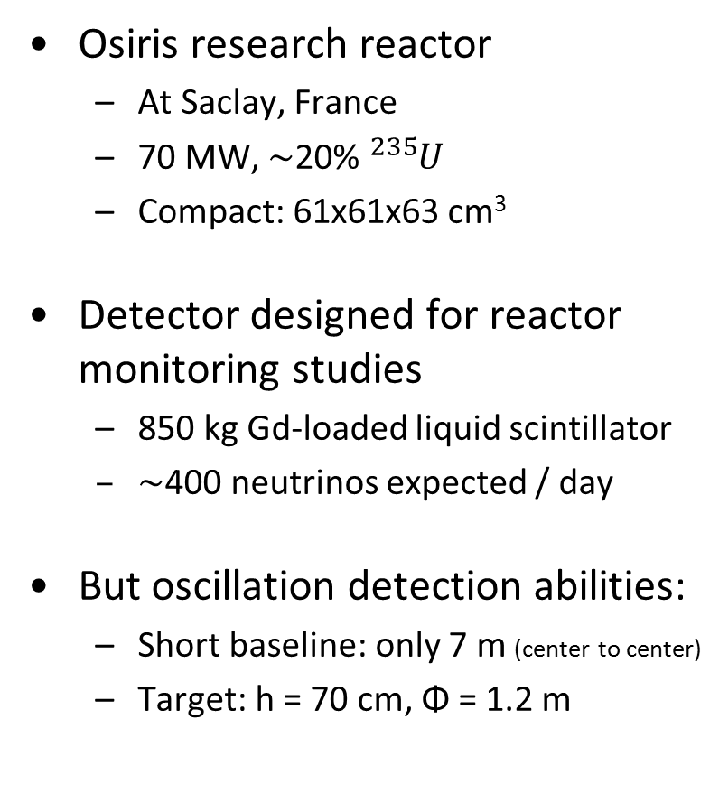
Nucifer experiment
Contact: T. Lasserre, D. Lhuillier, M. Fallot
Osiris research reactor
  At Saclay, France
  70 MW, $\sim$20% ${}_{}^{235}U$
  Compact: 61x61x63 cm³
Detector designed for reactor monitoring studies
  850 kg Gd-loaded liquid scintillator
  $\sim$400 neutrinos expected / day
But oscillation detection abilities:
  Short baseline: only 7 m (center to center)
  Target: h = 70 cm, Φ = 1.2 m
70 MW
7 m

Slide 10
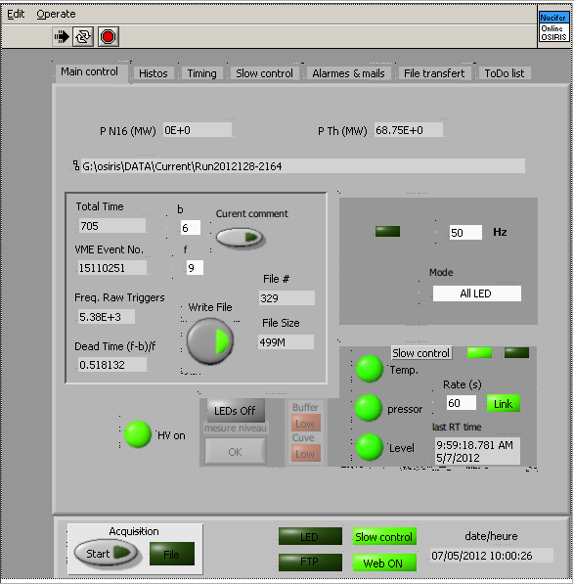
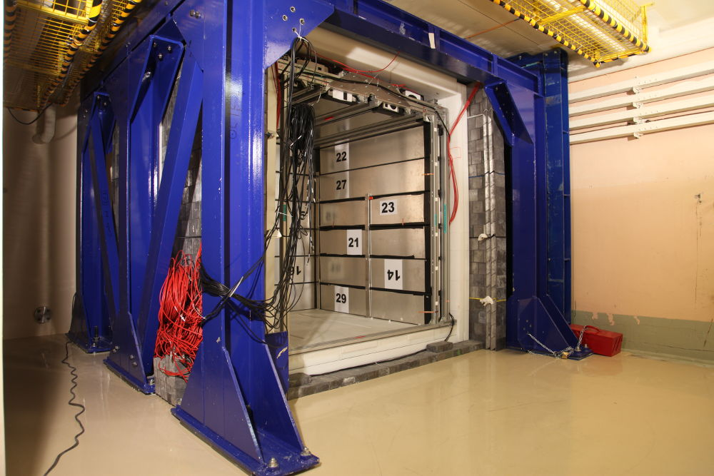
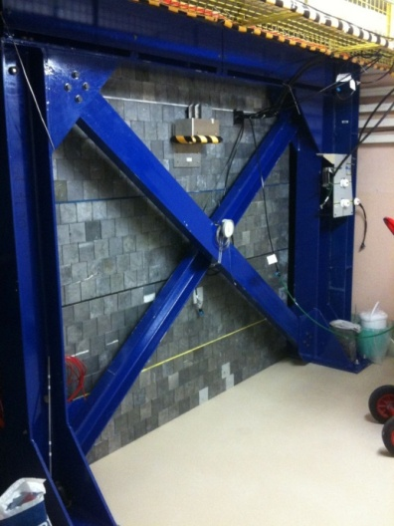
Commissioning and data taking
Data taking since april 2012
  Agreement from French
  National Security Agency (ASN)
Remote control & automatic
data transfert
Accurate monitoring (Rates, gains, P, T…)
Detector works well !
⁶⁰Co
Reactor
shutdown
AmBe

Slide 11
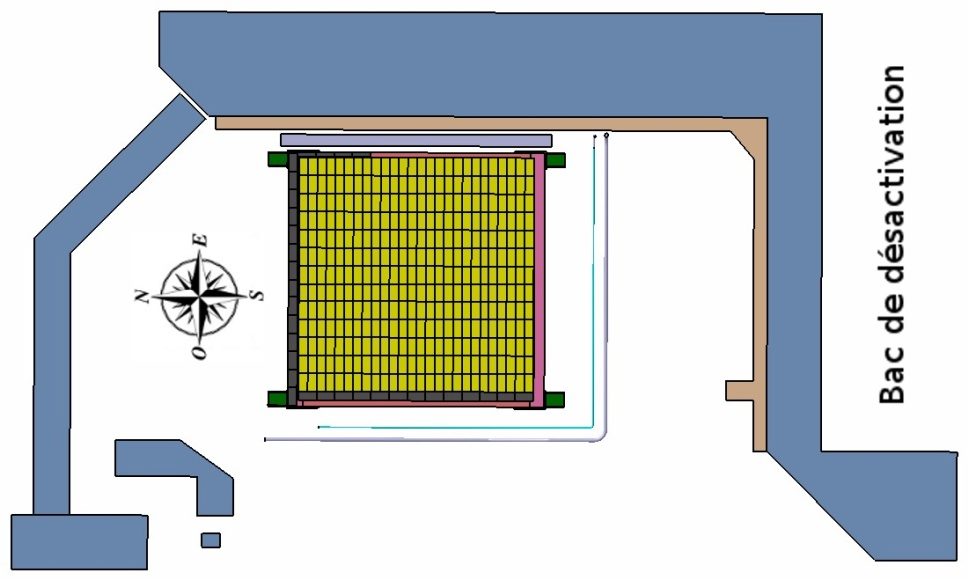
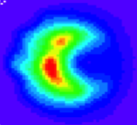
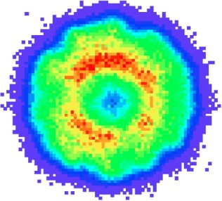

Accidental background
Reactor OFF background on expectation
core
primary loop
Unexpected reactor ON background
  $\sim$10 times higher than expected
  Point to south, but reactor at east
  Lead front wall is efficient
  Expected level at north
pool
3 m
East
water deactivation circuit
concrete
2 m
1.2 m
Primary loop water activation
  High energy γ leakage from ¹⁶N
South
4 m
New south lead wall
  Lead already acquired
  Installation at end of 2012
3.35 m
Barycenters of the PMT’s charges

Slide 12
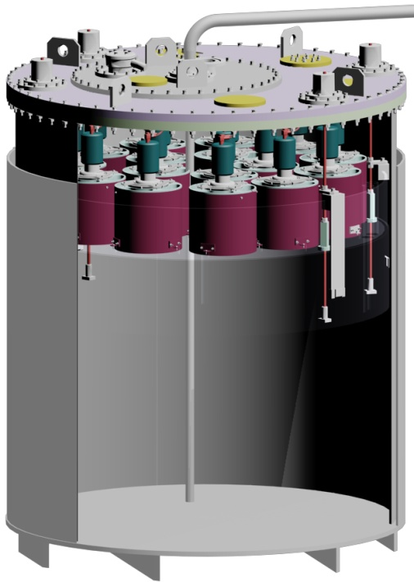
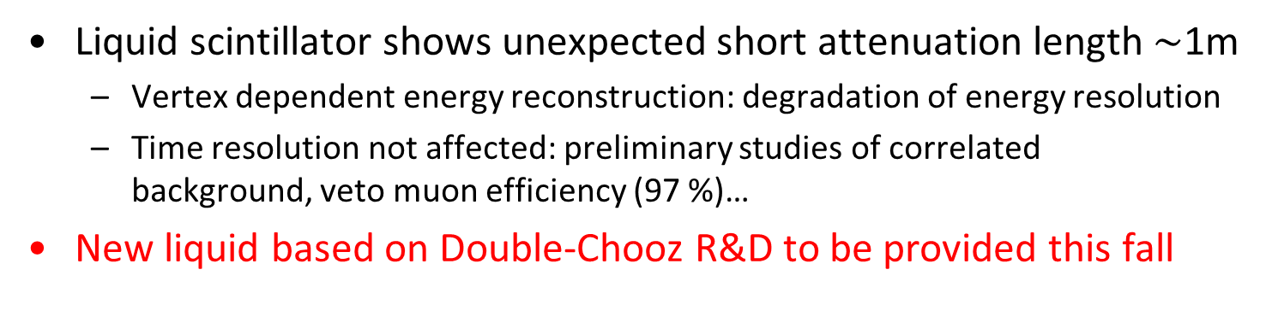
Liquid scintillator upgrade
Liquid scintillator shows unexpected short attenuation length $\sim$1m
  Vertex dependent energy reconstruction: degradation of energy resolution
  Time resolution not affected: preliminary studies of correlated
  background, veto muon efficiency (97 %)…
New liquid based on Double-Chooz R&D to be provided this fall

Slide 13



Contour after upgrades
Upgrades planned to be finished early 2013
With upgrades:
300 days @ Osiris
S/B=1.5
$δE_{scale}$= 2%
MC detector response
Ref spectra uncertainty
Best fit $Δm^{2}$ and $\sin^{2}{2θ}$
Expected spectrum distortion
- Error stat only -
If present, sterile $ν$ hint possible

Slide 14
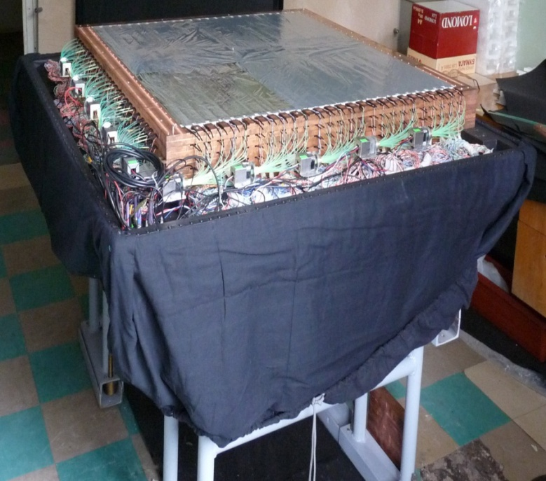
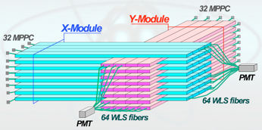
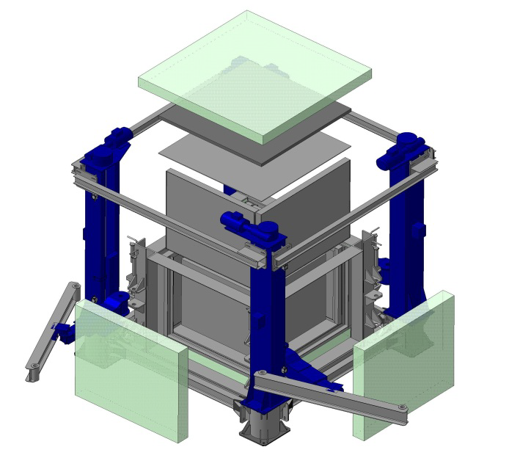
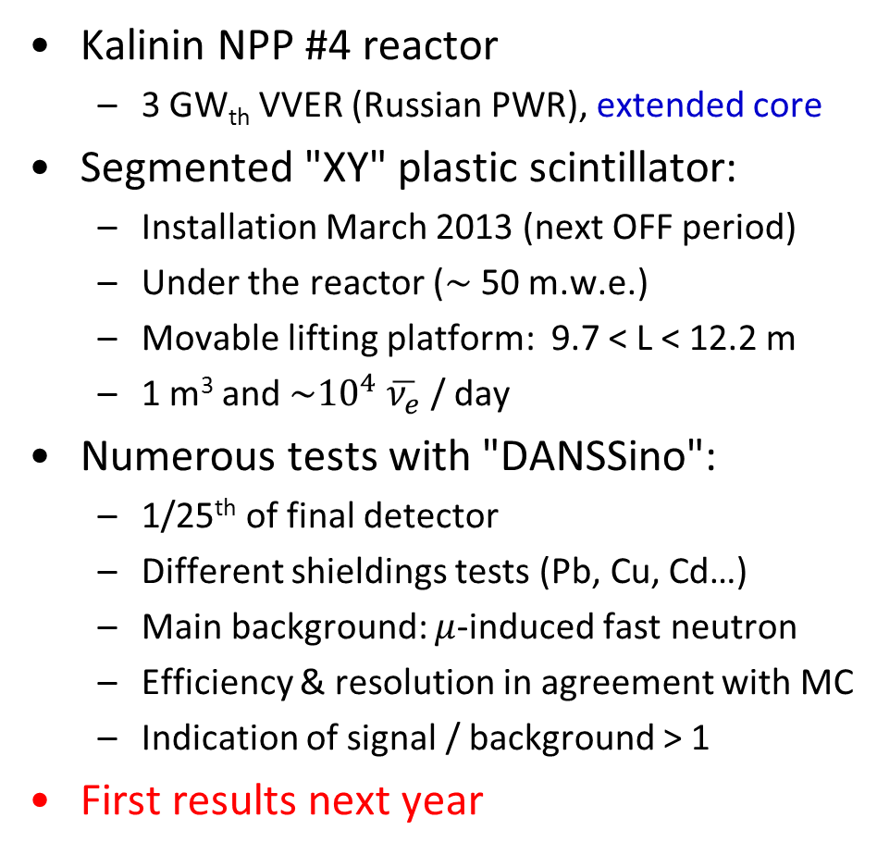
DANSS experiment
Contact: V. Egorov
Kalinin NPP #4 reactor
  3 GW_{th} VVER (Russian PWR), extended core
Segmented "XY" plastic scintillator:
  Installation March 2013 (next OFF period)
  Under the reactor ($\sim$ 50 m.w.e.)
  Movable lifting platform: 9.7 < L < 12.2 m
  1 m³ and $\sim {10}^{4} \overline{ν_{e}}$ / day
Numerous tests with "DANSSino":
  1/25th of final detector
  Different shieldings tests (Pb, Cu, Cd…)
  Main background: $μ$-induced fast neutron
  Efficiency & resolution in agreement with MC
  Indication of signal / background > 1
First results next year

Slide 15
NEW DEDICATED PRojects
SCRAAM
STEREO
NEUTRINO-4
POSEIDON

Slide 16
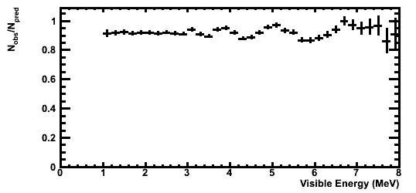
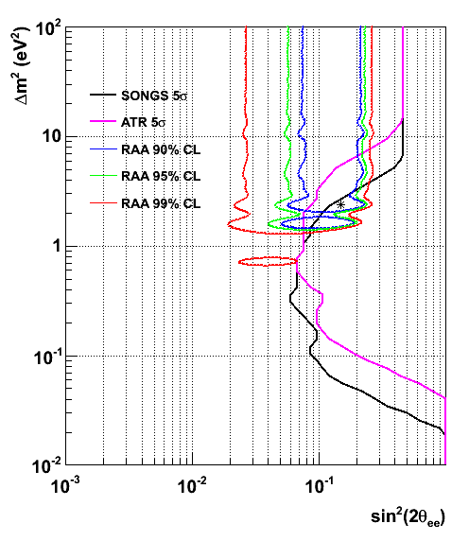
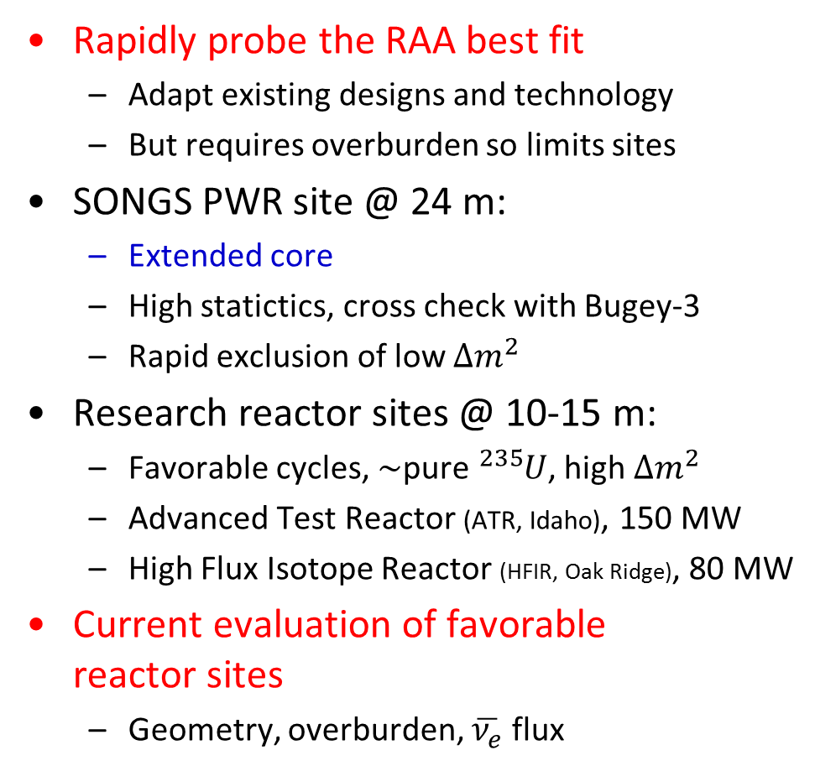
SCRAAM project
Contact: N. Bowden
Rapidly probe the RAA best fit
  Adapt existing designs and technology
  But requires overburden so limits sites
SONGS PWR site @ 24 m:
  Extended core
  High statictics, cross check with Bugey-3
  Rapid exclusion of low $Δm_{}^{2}$
Research reactor sites @ 10-15 m:
  Favorable cycles, $\sim$pure ${}_{}^{235}U$, high $Δm_{}^{2}$
  Advanced Test Reactor (ATR, Idaho), 150 MW
  High Flux Isotope Reactor (HFIR, Oak Ridge), 80 MW
Current evaluation of favorable
reactor sites
  Geometry, overburden, $\overline{ν_{e}}$ flux
Spectral distortion @SONGS (24m),
ΔE/E=10% @ 1MeV
sin²(2θ) =0.165, Δm² =2.4 eV²

Slide 17
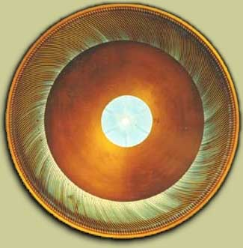
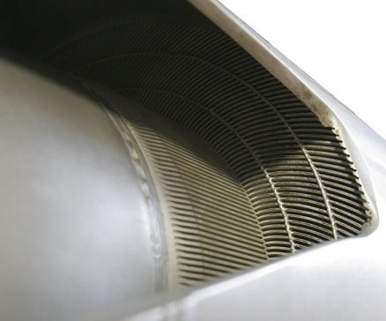
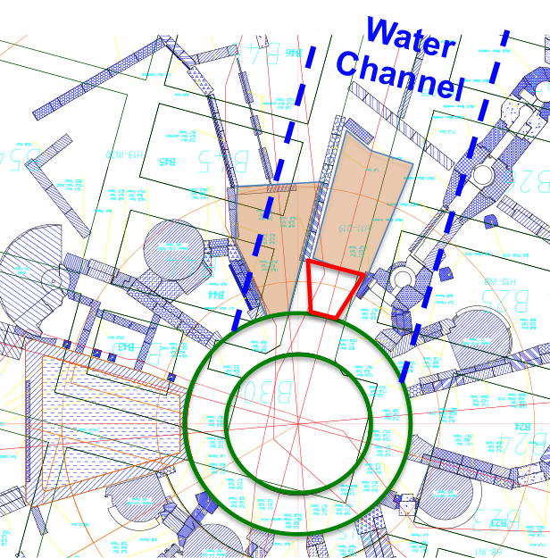
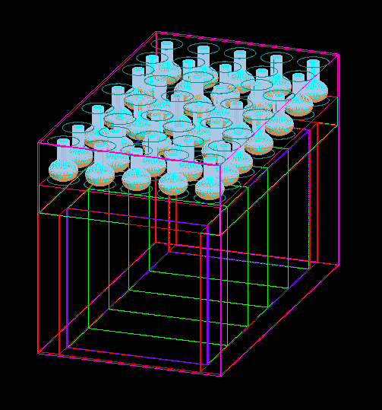


STEREO project
Contact: D. Lhuillier
French and German project
ILL research reactor (Grenoble):
  57 MW, highly enriched U
  Compact: h = 80 cm, Φ = 40 cm
Dedicated detector:
  5 segments: L and E oscillation
  Active outer layer: high efficiency + veto
  Muon flux attenuation = 4,
  thick CH₂ and Pb walls (70 t)
40 cm
36 cm
Site being discussed with ILL
  Target:
  Gd-doped liquid scintillator
5 m

Slide 18
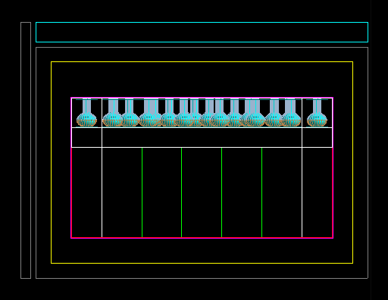
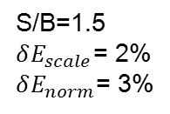
STEREO contour and phase shift
A phase shift of the oscillation is expected, no input from reactor.
Unambiguous signature of neutrino oscillation
S/B=1.5
$δE_{scale}$= 2%
$δE_{norm}$= 3%
MC detector response
Ref spectra uncertainty
Best fit, shape + norm, 300 days

Slide 19
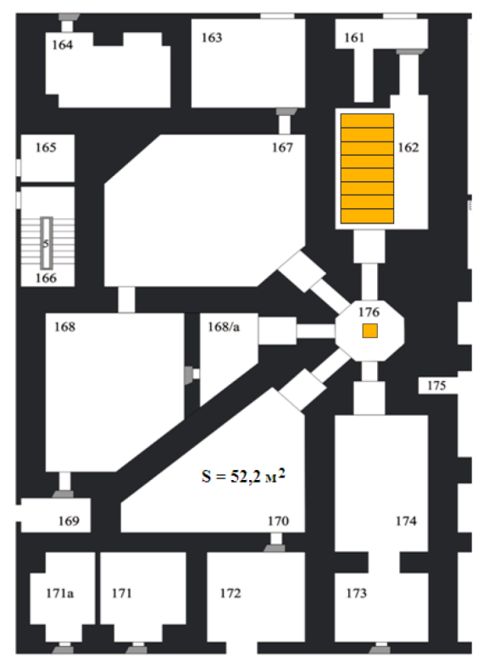
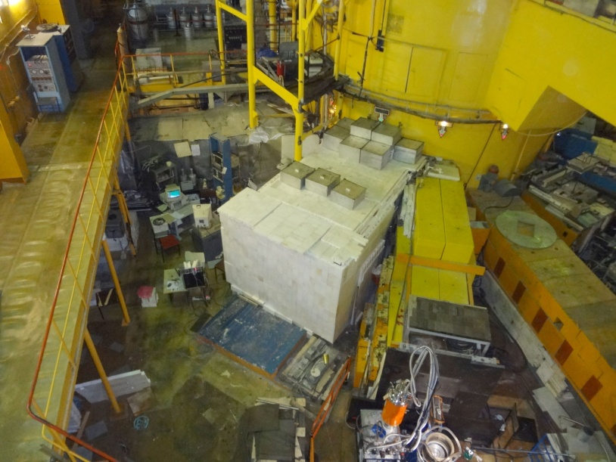
NEUTRINO-4 experiment
Contact: A. Serebrov
SM-3 reactor in Dimitrovgrad (Russia):
  100 MW compact core (35x42x42 cm³)
2 detector geometries currently studied:
  24 sections 1.4x1.0x1.0 m³
  5 sections moveable at 6-12 m
Preparation at WWR-M reactor in Gatchina
Future realization at SM-3
detector
at SM-3,
95% C.L.
5 m
core
24 sections
5 sections
WWR-M reactor, 18 MW
Shielding studies
SM-3 reactor

Slide 20
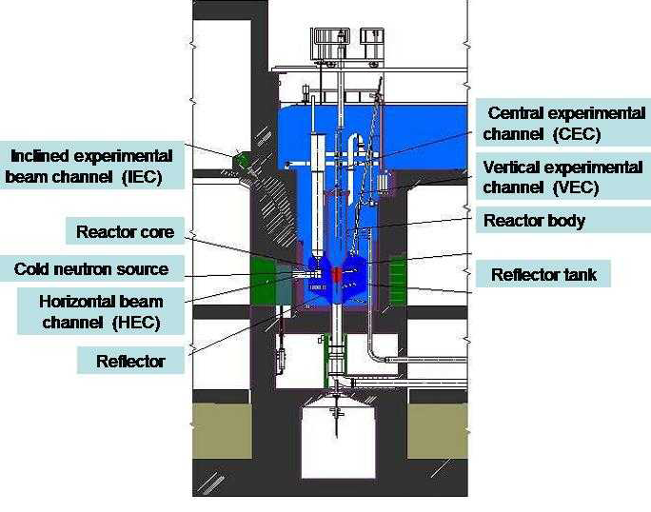
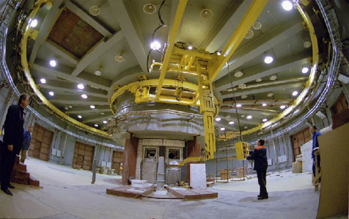
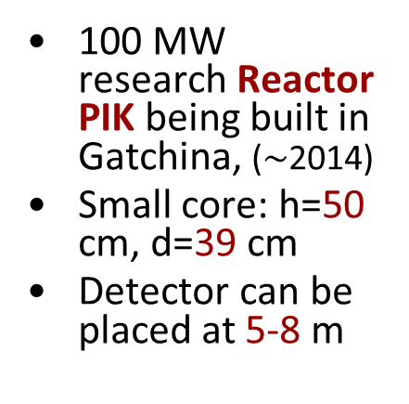
POSEIDON – POsition SEnsItive Detector Of Neutrino
Contact: A. Derbin
100 MW research Reactor PIK being built in Gatchina, ($\sim$2014)
Small core: h=50 cm, d=39 cm
Detector can be placed at 5-8 m
Gd loaded liquid scintillator detector: 2.1x1.3x1.3 m³
Region of sensitivity:
δm² = (0.3 - 6) eV² sin²(2θ)≥ 0.01
64 6” PMTs
15 cm
Veto+anti511
LAB+PPO+Gd
Energy and spatial resolution
should allow to observe the oscillation curves for different E_{ν}

Slide 21
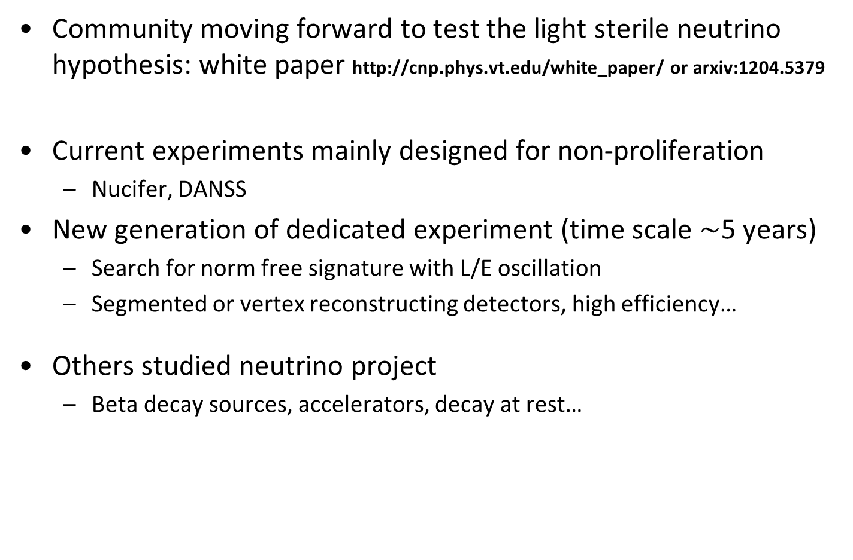
Conclusions
Community moving forward to test the light sterile neutrino hypothesis: white paper http://cnp.phys.vt.edu/white_paper/ or arxiv:1204.5379
Current experiments mainly designed for non-proliferation
  Nucifer, DANSS
New generation of dedicated experiment (time scale $\sim$5 years)
  Search for norm free signature with L/E oscillation
  Segmented or vertex reconstructing detectors, high efficiency…
Others studied neutrino project
  Beta decay sources, accelerators, decay at rest…

Slide 22
Back-up

Slide 23
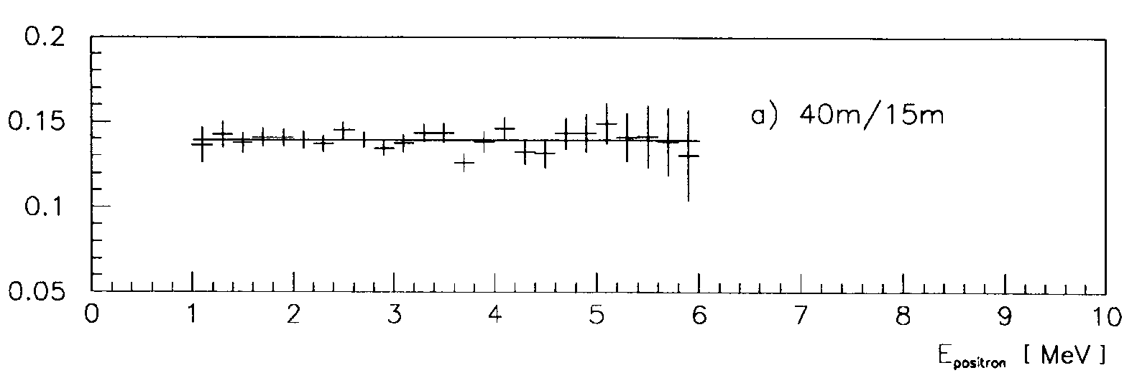
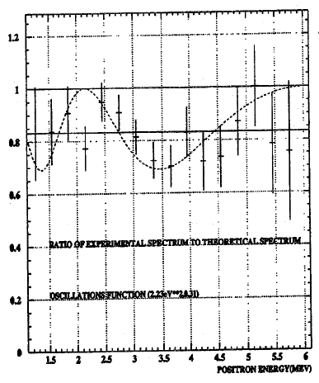
Shape only data
Bugey3 comparison 40m/15m:
Bugey (1995)
ILL pattern (not statistically significant)
ILL (1981 – reanalysis 1995)

Slide 24
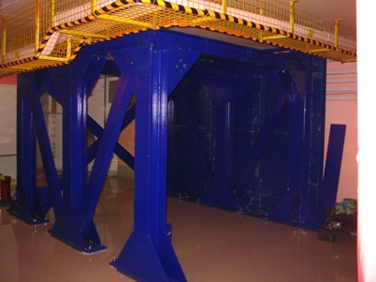
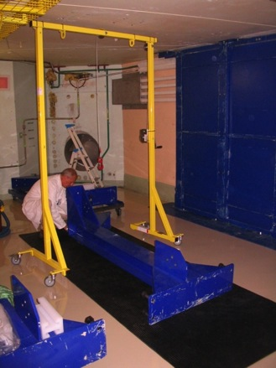
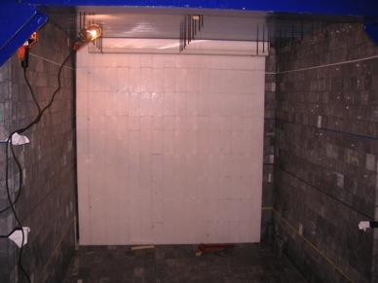
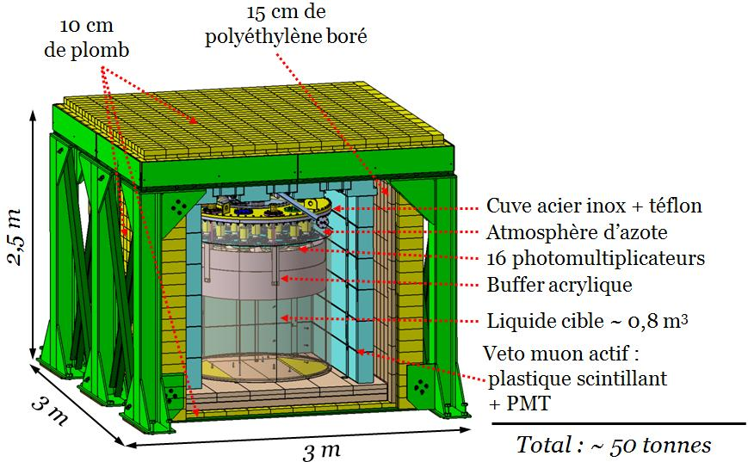

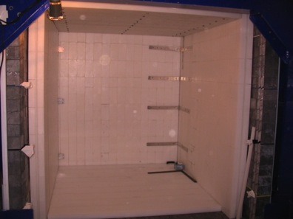
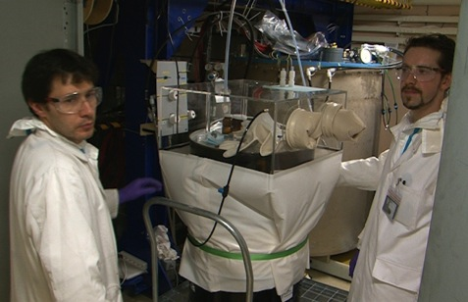
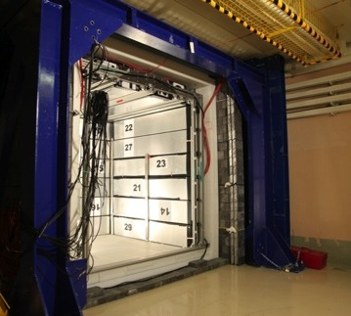
Nucifer Intallation
Shielding support
Lead front wall
Lead shielding
CH2 shielding
Filling
Muon veto

Slide 25
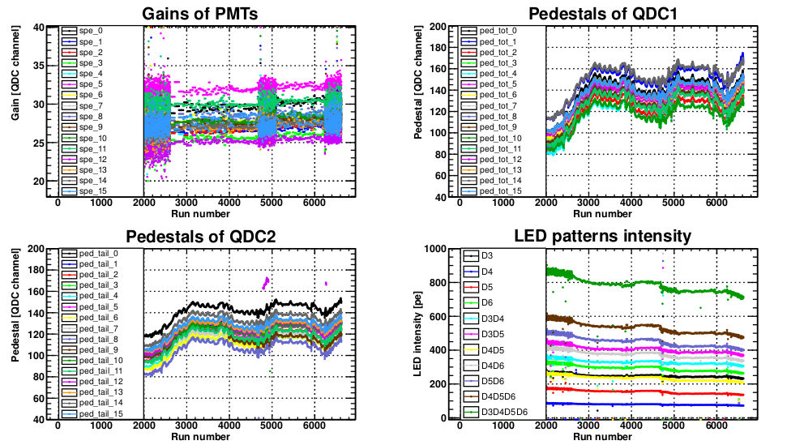
Photoelectron calibration
LED + fiber + diffuser
→ single photoelectron signal
Automatic fit of spe (16 ch)
→ pedestal + gain
Others LED for stability, linearity
Pedestal +- 0.5%
Gain +- 2.5 %
Measured each run or 10 runs (need statistic)

Slide 26
Sources simulation

Slide 27
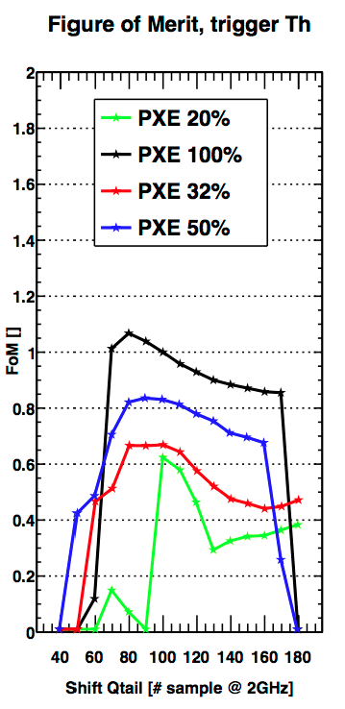
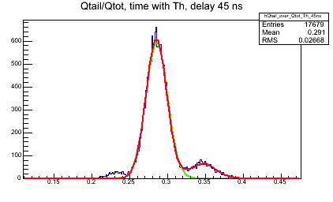
Pulse Shape Discrimination in Nucifer
PXE 50% - Dodecane 50%

Slide 28
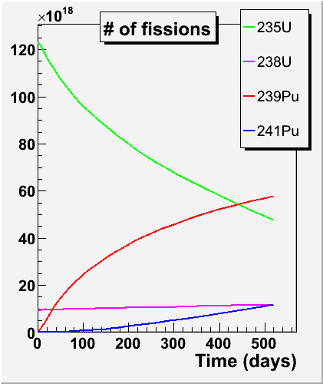
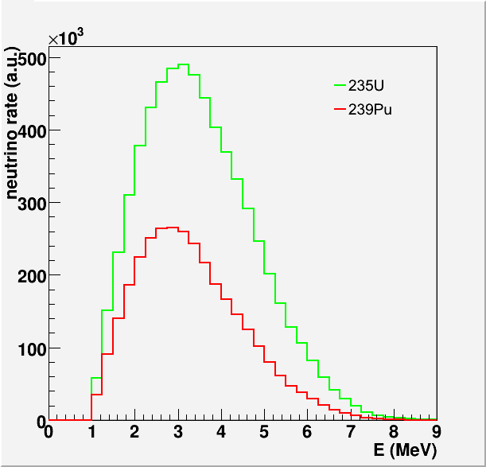
Reactor Spectrum Calculation
α_{235U}
α_{239Pu}
→ Sensitivity to plutonium content

Slide 29

Neutrinos & non proliferation
  1m³ detector 25 m away from a 3 GW reactor → 2000 interactions/d
Reactor operating at constant power
P (GW)
At fixed power the ν rate decreases as Pu accumulates in the core
Arrêt réacteur
rechargement
d’1/3 du
combustible
  A neutrino working group was created last year by the AIEA

Slide 30



Passive Shielding
Concrete
Study of cosmic rays attenuation at surface performed for the MAJORANA collaboration*
Favor thick light materials.
Lead
Iron
*Cosmic Ray Interactions in Shielding Materials, E. Aguayo et al, PNNL-20693

Slide 31
STEREO shape only contours
Background shape uncertainty

Slide 32
DANSS contour from Saclay team
Shape only analysis
Core size prevents effective oscillation detection

Slide 33
Mean cross-section per fission
ν-flux: ²³⁵U +3.7%, ²³⁹Pu +4.2%, ²⁴¹Pu +4.7%, ²³⁸U +9.8% (σ_{f}^{pred} )
Neutron lifetime decrease by a few % (σ_{f}^{pred} )
Off-equilibrium corrections (σ_{f}^{pred} )
Updated cross-sections per fission:
new/old
+4.7%
+5.0%
+9.7%
+5.2%

Slide 34

ν spectrum emitted by a reactor
=
Σ all fission products

Slide 35
Accurate prediction of reactor ν spectra
Reactor data
Reactor evolution codes
Thermal power
δP_{th} ~ 0.5% at commercial reactors
Fraction of fissions from isotope k, δα_{k}=few %
Nuclear databases
ν spectrum per fission
Dominant source of uncertainty
E released per fissions of isotope k, δE_{k}≈0.3%

Slide 36

Reactor Spectrum Calculation
Cross section / fission:
Detected spectrum / fission

Slide 37




The guts of S_{k}(E)
Sum of all fission products’ activities
Sum of all β-branches of each fission product
Theory of β-decay

Slide 38
Theory of β-decay
Fermi theory:
W = total energy
W₀ = end-point
p = momentum
Z = Nuclear charge
Phase space
Fermi function
Shape factor of forbidden
Corrections:
Finite size of nuclear electric charge
Screening of Atomic e-
Finite size distrib. of decaying neutron
QED radiative correction
Weak magnetism
ν branch obtained by replacing: W→W₀-W, G_{β}→G_{ν}

Slide 39
Corrections to Fermi theory
ν spectrum corrections
Example of a single branch with
Z=46
A=117
E₀=10 MeV
β spectrum corrections
P. Huber
Total fission spectra is a sum over a quasi continuous end-point distribution → +/- cancellation at low E, adds up at high E.
Can’t neglect this when looking for oscillation patterns or accurate total rate.

Slide 40

Neutron Life time
Continuous decrease of τ_{n} in the history of measurements
Latest average including MAMBO II result: τ_{n} = 881.5 s

Slide 41









ILL data: reference β⁻ Spectra
Accurate e⁻ measurements @ ILL in Grenoble (1978-89)
Magnetic BILL
spectrometer
Emitted β spectra per fission
e⁻
Target foil
(²³⁵U, ²³⁹Pu, ²⁴¹Pu)
in thermal n flux
ILL research reactor
(Grenoble, France)
W. Mampe et al., Nucl. Instrum. Meth. 154 (1978).
A. A. Hahn, K. Schreckenbach et al., Phys. Let. B218,365 (1989)+ refs therein

Slide 42

Normalization of ILL data
Dominant systematic error : 1.8 % (1 σ)
Absolute calibration via internal conversion electron lines of known partial cross section per neutron capture
Correlated across all energy bins of all isotopes
+ directly propagates into the converted antineutrino spectra.
¹¹⁵In(n, γ)^{116m}In
²⁰⁷Pb(n, γ)²⁰⁸Pb
&
: absolute normalization
¹¹³Cd(n,γ)¹¹⁴Cd
: relative normalization

Slide 43


e⁻→ ν conversion
Exact conversion requires complete knowledge from fission yield down to β⁻
transition between parent ground (or isomeric)-state and daughter states
β-branch level
Fission product level
Lot of relevant quantities: Z, A, End-points, J^{π}, nuclear matrix elements, branching ratios, fission yields, life time… but scarce data as E₀ increases

Slide 44

Conversion of reference e⁻ spectra
1- Fit total e⁻ spectrum with a sum of 30 effective β branches determined by iterative method (instead of ~10,000+ real branches)
2- Convert each effective e⁻ branches to ν branches
3- Sum all converted ν branches to get total ν spectrum
K. Schreckenbach et al., Phys. Lett. 99B, 251 (1981).
A.A. Hahn et al., Phys. Lett. 218B, 365 (1989).

Slide 45
ILL ν spectra
Emitted spectrum / fission
Converted energy spectrum S(E) for ²³⁵U, ²³⁹Pu and ²⁴¹Pu.
Reference spectra over the last 25 years
Ab initio calculation for ²³⁸U spectrum + new data from FRM2
(Nils Haag et al.)

Slide 46

New Predictions of ν Spectra
Th. Mueller et al, Phys. Rev. C83,054615 (2011)
Residuals to reference ILL data
+3% normalization shift
with respect to ILL ν spectrum
Similar result for ²³⁵U and Pu isotopes, +9.8% for ²³⁸U because of more complete ab initio approach.
Origin of the bias well identified:
  - Effective implementation of corrections to Fermi theory
  - Nuclear charge distribution of virtual branches

Slide 47
Confirmed by Independent Work
P. Huber, Phys. Rev. C84, 024617(2011)
New conv.
New conv. with simple β-shape
Mixed-approach
ILL inversion
Confirms global increase of predicted spectrum
Fixes remaining oscillations of mixed-approach prediction
Extra deviation at high energy from more complete correction to Fermi theory.
ν-flux: ²³⁵U +3.7%, ²³⁹Pu +4.2%, ²⁴¹Pu +4.7%

Slide 48

Reanalysis of All Short Baseline experiments

Slide 49






19 measurements @ L<100m
Krasnoyarsk
Rovno
Bugey
Savannah River
Goesgen
ILL
Different detector technics, different core compositions, different backgrounds, …

Slide 50
19 measurements @ L<100m
Variety of detection techniques, baselines, core compositions,…
meas/pred

Slide 51





Correlation Matrix
(correlation matrix on Ratios)
(in %)
Bugey-4 15m
Rovno91 18m
Bugey-3 15m
Bugey-3 40m
Bugey-3 92m
Goesgen 38m
Goesgen 45m
Goesgen 65m
ILL 9m
Krasno 33m
Krasno 92m
Krasno 57m
SRP I 18m
SRP II 25m
Rovno88 1I 18m
Rovno88 2I 18 m
Rovno88 1S 18m
Rovno88 2S 25m
Rovno88 3S 18m
3.0 | 3.0
3.9 | 3.0
5.0 | 5.0
5.1 | 5.0
14.1 | 5.0
6.5 | 6.0
7.6 | 6.0
9.5 | 6.0
5.1 | 4.1
5.1 | 4.1
20.3 | 4.1
4.1 | 4.1
3.7 | 3.7
3.8 | 3.7
6.9 | 6.9
6.9 | 6.9
7.8 | 7.2
7.8 | 7.2
7.2 | 7.2
Global 2% correlated norm error of ILL β-spectra
Block correlations come from identical detector, technology or ν source

Slide 52


²³⁸U β spectrum soon to be published
New ²³⁸U data @ FRMII reactor, Munich
Anchor point of 235U measurement:
- Background well understood.
- Comparison to ILL spectrum cancels most uncertainties.
n flux
Natural U foil
β
MWC
Plastic
Scintillator
N. Haag, K. Schrekenbach et al.
N. Haag Ph.D. thesis to be published by end of this year.
Analysis of electron data is final, conversion to neutrino on progress.

