Slide 1
The formation of the modern idea of neutrino
Francesco Vissani, GSSI and Gran Sasso Laboratory
Neutrino appear in physics just after the relativistic description of the electron. We know a lot but on them, but not all. Some of the open questions are still the early ones. We recall the original ideas on neutrinos, stressing their surprising character.¹⁾ This will also offer us a good occasion of testing/reinforcing the basis of the subsequent discussion.
¹⁾ Refined ideas are advantageous but only rarely retain the initial creative power; moreover, some sets of concepts (e.g., Dirac equation, standard model) go very far and do not allow to understand which possibilities were left aside.

Slide 2
Neutrinos and their interactions
In the beginning was the nucleus:
β rays, β decay, β interactions…

Slide 3
Nuclear phenomena
Nuclei are discovered about 100 years ago (Geiger, Marsden, Rutherford)
Some of them emits various visible radiation: α, β, γ rays
β is electron (Bequerel) γ is light (Einstein) α is He4 (Rutherford)
Note that while we talk commonly of “electromagnetic radiation”, after Maxwell’ theory, we use still the old terminology to describe nuclear phenomena

Slide 4
Characterization
Radiations are characterized by their penetration power (see figure)
Their emission spectra are remarkably different:
Fixed energy carried by α, γ rays
Variable energy carried by β rays

Slide 5
The prevailing theory till mid thirties
Nuclei are made of protons and electrons
Emitted β rays are thought as “nuclear electrons”
E.g., tritium decay is H3 = (3p, 2e) --> He3=(3p, 1e) + β
We expect fixed energy – but we find variable one!

Slide 6
The prevailing theory till mid thirties
Nuclei are made of protons and electrons
Emitted β rays are thought as “nuclear electrons”
E.g., tritium decay is H3 = (3p, 2e) --> He3=(3p, 1e) + β
We expect fixed energy – but we find variable one!
Maybe there is a full sequence of final state He3 (Goppert-Mayer)
Maybe energy is not conserved? (Bohr)

Slide 7
The prevailing theory till mid thirties
Nuclei are made by protons and electrons
β rays are then called nuclear electrons
E.g., tritium decay is H3 = (3p, 2e) --> He3=(3p, 1e) + β
We expect fixed energy – but we find variable one
Maybe there is a full sequence of final state He3 (Goppert-Mayer)
Maybe energy is not conserved? (Bohr) NOT EVIDENTLY WRONG

Slide 8
The prevailing theory till mid thirties
Nuclei are made by protons and electrons NOT EVIDENTLY WRONG
β rays are then called nuclear electrons
E.g., tritium decay is H3 = (3p, 2e) --> He3=(3p, 1e) + β
We expect fixed energy – but we find variable one
Maybe there is a full sequence of final state He3 (Goppert-Mayer)
Maybe energy is not conserved? (Bohr)

Slide 9
The invisible particle
On Dec 1930 Pauli postulated that nucleus contains also neutral particles
E.g., tritium nucleus H3 is a bound state containing (3p,2e,nν)
Assume β decay is H3 = (3p, 2e, nν) --> He3=( 3p , 1e , (n-1)ν ) + β + ν
The new particles are almost invisible, but carry away the energy
Pauli felt miserable and did not publish this idea for 3 years (also: divorce, nervous breakdown)

Slide 10
The invisible particle
… because of the "wrong" statistics of the N- and Li-6 nuclei and the continuous beta spectrum, I have hit upon a desperate remedy to save the "exchange theorem” of statistics and the law of conservation of energy. Namely, the possibility that in the nuclei there could exist electrically neutral particles, which I will call neutrons, that have spin ½
(Forget names, he says “neutron” but he has in mind the particle that is emitted)
If N-14 = (14p,7e) the nuclear spin is semi-integer -- but it is measured to be integer.
If the nucleus contains an odd number of these neutral particles (e.g., n=7) all OK.
Pauli’s improvement of the proton+electron theory was not fully abandoned for 30 years at least

Slide 11
Fermi theory (quantum mechanics + relativity)
We are in 1933: positron is found, Dirac theory is accepted and neutron is known
Fermi postulates an Hamiltonian H that describes β decay as transformation of particles: E.g., neutron decay requires the matrix element < p e⁻ ν | H | n > ≠ 0
H written with relativistic quantum fields, that resemble ladder operators. E.g. disappearance of electron or appearance of positron is described formally by < 0| Ψ_{e} | e⁻ > ≠ 0 or < e⁺ | Ψ_{e} | 0 > ≠ 0
It follows also that < n e⁺ | H | p ν > ≠ 0, thus, neutrinos are not invisible
In any case, the matrix elements are small: β interactions are weak
Paper rejected by Nature and published in an obscure Italian journal

Slide 12
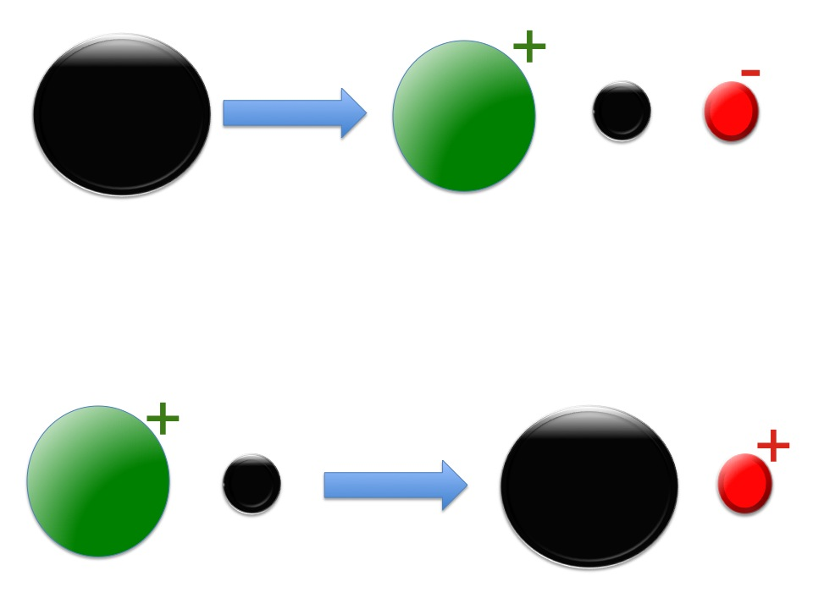
Neutrino
Electron
Neutron
Proton
Neutrino
Anti-
Electron
Proton
Neutron

Slide 13
Bethe Peierls 1934
The ratio: ( β decay width ) / ( ν cross section ) is independent on the dynamics of weak interactions. It has dimension mass³ .
Assume mass=1 MeV. Using the typical β decay time of about 1 second estimate the cross section σ = π x R² with R = 3 ym < 10⁻²¹ cm
“This meant that one obviously would never be able to see a neutrino”
Paper published on Nature with the title The `neutrino’

Slide 14
`Neutrino’ - free proton interaction
Exercise:
Cross section is proportional to G_{F}² × d³p_{n} × d³p_{e+} × δ⁴(p_{ν} +p_{p}-p_{n}-p_{e+})
where G_{F}² ≈ 5 10⁻⁴⁴ (cm/MeV)² (I use modern notation here)
Show that it is proportional to G_{F}² p_{e+} E_{e+} with E_{e+}=E_{ν}-(m_{n}-m_{p}) when the neutron recoil can be neglected
Compare with Bethe Peierls estimation
Comment and discuss

Slide 15
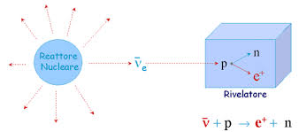
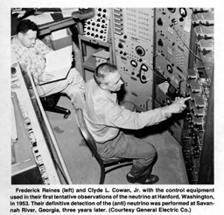
Proof of the existence of the `neutrino’
The experiment was successfully conducted by Reines & Cowan in 1956.
39 years later, this result was recognized by the Nobel prize in Physics awarded to Reines.

Slide 16
Other types of neutrinos
(n,p)
Pontecorvo studied e-capture and μ-capture and suggested that the coupling is same (1947)
Puppi suggested that the muon is associated to a new type of neutrino, as depicted in the triangle (1948)
This suggests that weak interactions treat in the same way the various pairs of particles
For the pair (n,p), this is almost true
(e,ν_{e})
(μ,ν_{μ})

Slide 17
Other types of neutrinos
(n,p)
Pontecorvo considered e-capture and μ-capture and suggested that the coupling is same (1947)
Puppi suggested that the muon is associated to a new type of neutrino, as depicted in the triangle (1948)
This suggests that weak interactions treat in the same way the various pairs of particles
For the pair (n,p), this is almost true
(e,ν_{e})
(μ,ν_{μ})
WHY?

Slide 18
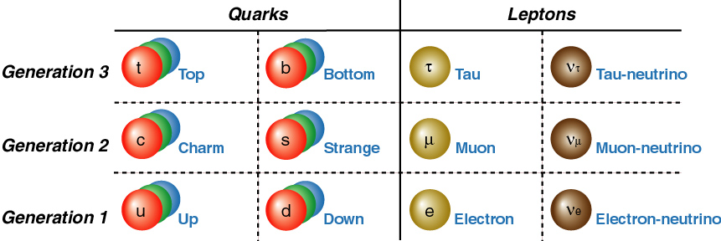
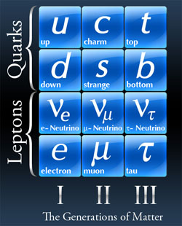
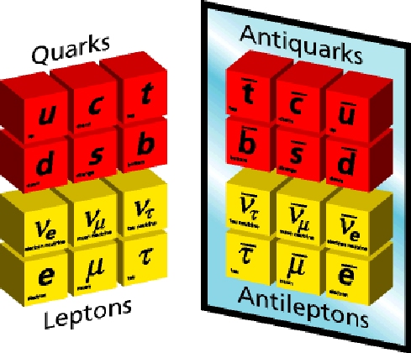

Slide 19
(hadrons and β interactions - a long story made short)
β interactions couples families: this is the only reason why heavier particles are unstable
Couplings between mass states are different, but in another sense, they are universal
The first complete and correct understanding of these facts is due to Cabibbo (1963)
This `universality’ is better understood in terms of quarks (1964)
I assume you know this: otherwise, let us sit together to recall it, after the lecture. Before passing to neutrino masses, we should discuss now two last aspects concerning neutrino interactions.

Slide 20
More neutrino interactions – the `heavy photon’
The idea that neutrinos could feel new interactions was present since early times
The Z⁰ of SU(2)xU(1) model (Glashow 1961) plays exactly such a role
Z⁰ treats ν _{e}, ν _{μ}, ν _{τ} in the same manner -- just as the photon treats equally e, μ, τ
LEP checked that the number of light, ordinary neutrinos is just 3 (1993-99) by measuring Z⁰ width
Gargamelle experiment

Slide 21
Goldhaber Experiment (1957)
A spin-0 nucleus captures an electron,
then chain-decays till another spin-0 nucleus
Final Neutrino Spin
Final Photon Spin
(invisible)
(observable)

Slide 22
Comments
Electron capture (EC) with emission of neutrinos is due to the same Hamiltonian that causes β decay and ν interaction.
Neutrinos are always emitted with the spin opposite to the momentum. In jargon: the helicity of the neutrino is always negative.
Then, theory predicts that the particle associated to positron (by definition, antineutrino) has the opposite property, i.e., positive helicity
In short, the definition of what is a neutrino and what is an antineutrino can be given by mean of the associated charged particle or of its helicity

Slide 23
Neutrinos vs antineutrinos

Slide 24
Description of massless free neutrinos in QM
H₀ = - σ^{j} p^{j}
where p^{j}=-i d/dx^{j} is the momentum and σ^{j} Pauli’s matrices. Note the spin-momentum connection. This is called also Weyl equation (we use h-bar=c=1 here)
EXERCISE: Check how this fits with the description given in terms of Dirac’s eq., that uses 4 dim spinors

Slide 25
Neutrino masses
in 4 points: kinematics, spectrum of β decay,
cosmology, neutrino oscillations

Slide 26
Neutrino mass 1: kinematics
… electrically neutral particles […] that further differ from light quanta in that they do not travel with the velocity of light.
In other words, due to their mass, the neutrinos are slower than the photons.
Thus, neutrinos with more energy go faster, those with less energy go slower.
Recall that in 1930, at the time of the famous letter, Pauli was 30; he was just 21 years old when he wrote a complete description on the Theory of Relativity (237 pp)

Slide 27
The arrival of a cosmic neutrino rush
57 years later, a supernova was seen at 170,000 light year. Astronomers knew that neutrinos precede light and asked to check data on neutrino telescopes. Neutrinos with energies 7 to 40 MeV were found, in a burst of about 10 s, 3-4 hours before the light.
EXERCISE: Evaluate the effect due to neutrino mass on the transit time of neutrinos. Apply these considerations to obtain a bound on the mass.

Slide 28
Neutrino mass 2: the β spectrum
In β decay process, energy conservation implies E_{e}+E_{ν}=M_{in}-M_{fin}
When the energy of the electron is maximum, the one of neutrino is minimum
In this region of the spectrum, called endpoint, the effect of mass is maximum
We have a chance to observe the effect of neutrino mass (Fermi; Perrin)

Slide 29
What we know from the experiments
There are experiments that measure the differential β spectrum, that integrate the whole spectrum, that integrate only close to the endpoint
The best limit to date is from MAINZ and TROITSK: m_{ν}<2 eV
Future KATRIN experiment may improve this by 1 order of magnitude
EXERCISE: KATRIN will count events close to endpoint. Integrate phase space d³p_{ν} close to endpoint, using energy conservation, to find the distribution.

Slide 30
Neutrino mass 3: cosmology
In early instants, Universe was hotter and hotter (big-bang)
Weak interactions, whose rate is Γ_{β} ~ G_{F}² T⁵ kept neutrinos in thermal equilibrium till T ~ 1 MeV, when they exit from equilibrium
The presence of neutrinos influences the yield of D and He4. Measurements agree with this theory, called (primordial) big-bang nucleosynthesis -- or BBN.
EXERCISE: Use H²~G_{N} ρ with ρ~T⁴ to estimate the temperature of decoupling

Slide 31
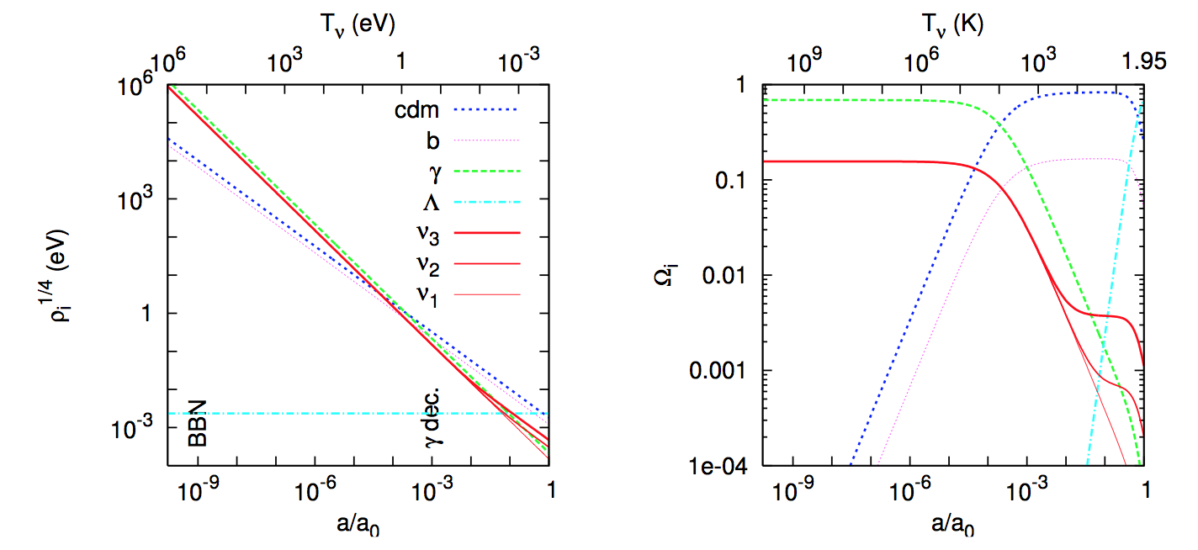
History of neutrinos
Today, we should have 56 /cm³ neutrino + antineutrinos per family
The average momentum of each of them is 0.5 meV
The CMB distribution is sensitive to the sum of their mass

Slide 32
Values and bounds on neutrino masses
Cosmological measurements yield information on neutrino masses
Results changed a lot in the course of the time. Recently, a tight limit was obtained
The very recent result of Hubble ST (1604.01424) could affect this conclusion

Slide 33
Neutrino mass 4: oscillations
The only method that succeeded in measuring non-zero masses to date is the one of neutrino oscillations -- aka, flavor transformation – recognized by the Nobel 2015
We introduce the principle following the historical developments
Basic formalism is sketched; connection with neutrino masses is described
First hint/proof from solar neutrinos is discussed
Effects of neutrino propagation in matter are mentioned

Slide 34
The idea of neutrino oscillations [1/2]
Gell-Mann and Pais theory on neutral kaons inspired Pontecorvo
Pontecorvo (1957) proposes that the same quantum phenomenon happens to neutrino-antineutrino (and also to neutron-antineutron, atom-antiatom, etc)
The correct physical picture needs neutrino mixing, introduced by Tokyo and Nagoya groups (1962) and connected to neutrino mass (Sakata et al 1963)
Using this framework, Pontecorvo obtains the modern description (1967)

Slide 35
The idea of neutrino oscillations [2/2]
Take a relativistic neutrino, i.e. a state of negative helicity, of electron flavor.
Suppose that it is not a mass (stationary) eigenstate but rather a mixed state
|ν_{e},0> = cosθ|ν₁> + sinθ |ν₂>
At a subsequent time t, after production, we have
|ν_{e},t> = exp(-i E₁ t) cosθ|ν₁> + exp(-i E₂ t) sinθ |ν₂>
Thus, we conclude that: | <ν_{e},0|ν_{e},t> | ≠ 1 and | <ν_{μ,},0|ν_{e},t> | ≠ 0

Slide 36
Suppose to have a superposition of two waves with different mass and thus different velocities. They are initially in phase. During the time they will go counter-phase, then again in phase, etc. It can be interpreted saying: initially we have |ν_{e}>; then we have |ν_{μ}>; then again |ν_{e}>….

Slide 37
Predictions vs experiment
Expectations on solar electron neutrinos (Bahcall 1964) are not in agreement with Davies’ observations (late 60’s)
The explanation of Pontecorvo is the following one:
The electron neutrinos produced in the Sun do not maintain their flavor. Thus, when we search for them selectively, we will find a deficit in the expectations

Slide 38
SNO (Nobel 2015 ): total number of solar neutrinos agrees with Bahcall’ predictions

Slide 39
Exercise
Calculate the probability of appearance P_{e→μ} = | <ν_{μ,},0|ν_{e},t> |²
Prove the formula,
P_{e→μ} = sin² 2θ × sin² [( E₁ - E₂ ) t / 2 ]
Use the ultra-relativistic limit to obtain the most practical form,
( E₁ - E₂ ) t / 2 ≈ 1.27 ( m₁² - m₂ ²) / eV² × L/km × GeV/E
where L=c t, E₁ ≈ E₂ ≈ E and m_{i} are the neutrino masses.
Calculate the probability of disappearance P_{e→e} = | <ν_{e,},0|ν_{e},t> |²

Slide 40
(my favorite presentation of the concepts “neutrino= almost invisible and neutral particle” e “the masses of the corresponding visible particles differ a lot”.)

Slide 41
The neutral kaon system [1/2]
The first mesons to be observed were π⁺, π⁰, π⁻
At first sight, they seemed to have heavier copies Κ⁺, Κ⁰, Κ⁻, but it was realized that this analogy is misleading.
The Κ mesons are produced respecting a new conservation rule, strangeness: S=1 for Κ⁺, Κ⁰ and S=-1 for Κ⁻
Κ⁰ is not its own antiparticle, as π⁰: There is also a 4th meson, anti-Κ⁰
(today this is evident thanks to the quark model; but in 50ties it was not)

Slide 42
The neutral kaon system [2/2]
Gell-Mann Pais noted that strangeness is not an exact since we have the decay Κ⁰ --> π⁺ + π⁻ . Then, consider the free hamiltonian of the Κ⁰ anti-Κ⁰ system
The off-diagonal terms are not zero, since < π⁺ + π⁻ | Κ⁰ > is non zero. In 2nd order of perturbation theory, non-zero amplitude <anti-Κ^{0 |} H | Κ⁰ > arises
Thus, Κ⁰ and anti-Κ⁰ not the eigenstates of propagation.

