Slide 1
New Physics and Neutrino Mass: Facts and Fancy
Francesco Vissani
LNGS and GSSI

Slide 2
Introduction
Baryon and lepton numbers and their status in the standard model of particles and interactions

Slide 3
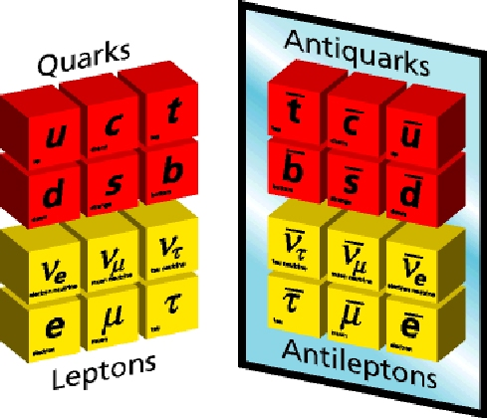
Lepton and baryon number
In all known transformations among particles,
# of leptons is unchanged
# of baryons (=# of quarks/3) is unchanged

Slide 4
(A , Z ) → (A , Z+1)+e⁻+ν_{e}
(A , Z ) → (A , Z+2)+2 e⁻
n → e⁻ + p
p → e⁺ + π⁰
n → e⁻ + K⁺
e⁻ → γ + ν_{e}
n → n
−
−

Slide 5
(A , Z ) → (A , Z+1)+e⁻+ν_{e} All OK
(A , Z ) → (A , Z+2)+2 e⁻
n → e⁻ + p
p → e⁺ + π⁰
n → e⁻ + K⁺
e⁻ → γ + ν_{e}
n → n
−
−

Slide 6
(A , Z ) → (A , Z+1)+e⁻+ν_{e} All OK
(A , Z ) → (A , Z+2)+2 e⁻ L changes
n → e⁻ + p
p → e⁺ + π⁰
n → e⁻ + K⁺
e⁻ → γ + ν_{e}
n → n
−
−

Slide 7
(A , Z ) → (A , Z+1)+e⁻+ν_{e} All OK
(A , Z ) → (A , Z+2)+2 e⁻ L changes
n → e⁻ + p L and spin change
p → e⁺ + π⁰
n → e⁻ + K⁺
e⁻ → γ + ν_{e}
n → n
−
−

Slide 8
(A , Z ) → (A , Z+1)+e⁻+ν_{e} All OK
(A , Z ) → (A , Z+2)+2 e⁻ L changes
n → e⁻ + p L and spin change
p → e⁺ + π⁰ B and L change
n → e⁻ + K⁺
e⁻ → γ + ν_{e}
n → n
−
−

Slide 9
(A , Z ) → (A , Z+1)+e⁻+ν_{e} All OK
(A , Z ) → (A , Z+2)+2 e⁻ L changes
n → e⁻ + p L and spin change
p → e⁺ + π⁰ B and L change
n → e⁻ + K⁺ B and L change
e⁻ → γ + ν_{e}
n → n
−
−

Slide 10
(A , Z ) → (A , Z+1)+e⁻+ν_{e} All OK
(A , Z ) → (A , Z+2)+2 e⁻ L changes
n → e⁻ + p L and spin change
p → e⁺ + π⁰ B and L change
n → e⁻ + K⁺ B and L change
e⁻ → γ + ν_{e} Charge changes
n → n
−
−

Slide 11
(A , Z ) → (A , Z+1)+e⁻+ν_{e} All OK
(A , Z ) → (A , Z+2)+2 e⁻ L changes
n → e⁻ + p L and spin change
p → e⁺ + π⁰ B and L change
n → e⁻ + K⁺ B and L change
e⁻ → γ + ν_{e} Charge changes
n → n B changes
−
−

Slide 12
Summary offered by known physics
Known physics= “standard model’’ (SM), an astonishing successful theory, based on few principles
The perturbative theory is compatible with lepton and baryon conservation
This is evident from the graphical representation of the processes, given by Feynman diagrams: there are no sources or sinks of B and L (see next example)

Slide 13
up
quark
down
quark
electron
neutrino
electron

Slide 14
Why bother with L and B tests, then?
We know that the SM is not the whole story:
Experimental facts
Some speculative arguments
Alternative principles can be/were conceived
SM can be thought of in a more relaxed sense
Some of these considerations are connected to neutrino masses

Slide 15
SM vs light neutrino masses
Masses of the standard model fermions; an old question on the nature of neutrino mass; how to enhance/modify the standard model

Slide 16
SM matter particles in one family
?
U
U
U
D
D
D
E
direction of motion
U
U
U
ν
D
D
D
E

Slide 17
Masses from coupling to spin-0 boson

Slide 18
(of course, the Higgs field takes vacuum expectation value, e.g.)

Slide 19
Fermion masses
We have masses for all charged particles
We cannot have mass for neutrinos
Oscillations imply that neutrinos have mass
Thus, we need to modify the SM
HOW?
Let us show that this can be done without new particles

Slide 20
Higgs
boson
Higgs
boson
Left
lepton
Left
lepton

Slide 21
Vacuum
expectations
Left
neutrino
Left
neutrino

Slide 22
Vacuum
expectations
Left
neutrino
Right anti-
neutrino

Slide 23
Recap on meaning of the arrows
Here, colored arrows indicate the flow of baryon and lepton number. Clashing arrows (source or sink) imply their violations
E.g., the above type of neutrino mass, that is called Majorana mass, violates lepton number
In order to understand well what happens to momentum, spin, helicity, it is better to consider another type of representation

Slide 24
ultrarelativistic limit (interactions)

Slide 25
rest frame (that exists)

Slide 26
Summary
It is possible to enhance SM adding a mass term for ordinary neutrinos, respecting its symmetries
We get the type of mass hypothesized by Majorana in 1937, where neutrinos=antineutrinos in rest frame
The price is that: the enhanced SM is not anymore “renormalizable”, it becomes an effective theory
Alternatively, we can add right-neutrinos. Interestingly, if they are heavy, we get just the same mass at low energies

Slide 27
HOW to test majorana mass
Gedanken experiment; detection of big-bang neutrinos; search for matter creation in laboratory, i.e., neutrinoless double beta decay

Slide 28
Gedanken experiment

Slide 29
Cosmological neutrinos [1/2]
Average cosmological neutrino momentum is 0.5 meV
Measured square roots of Δm² are 8.5 meV & 50 meV
Thus, at least for two species of neutrinos p_{ν}<<m_{ν}
If neutrinos are Dirac particles, half of those produced in big-bang are now non-interacting (sterile) states

Slide 30
Cosmological neutrinos [2/2]
Consider the reaction, ν_{e} + ³H → ³He + e⁻
Assume to have 100 g of tritium as target
We expect 8 events/year if Majorana, 4 if Dirac
The trouble is that tritium is radioactive and decays

Slide 31
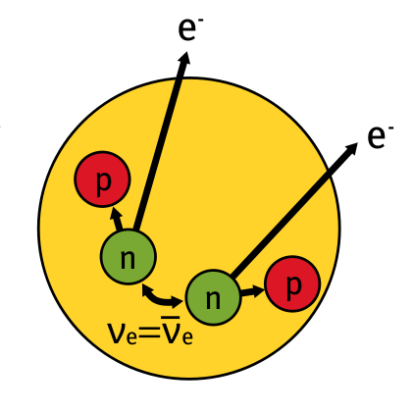
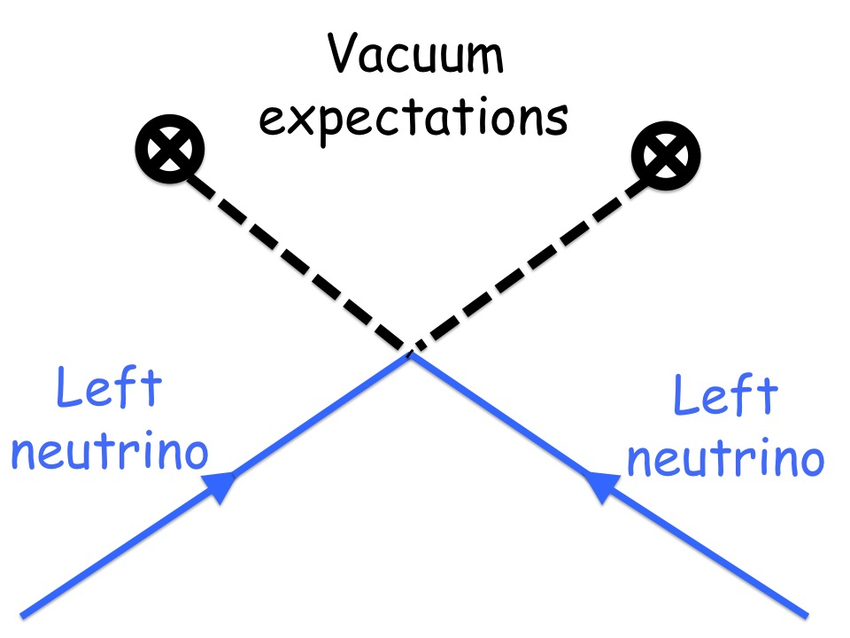
The Majorana mass term induces a decay similar to the one predicted by Goeppert Mayer (1935), namely (Racah; Furry ‘37)
(A,Z)
(A,Z+2) + 2 e⁻
as it is clear from the following pictorial representation:

Slide 32
Double beta decay
This nuclear process exists and can be investigated for some even-even nuclei (talk of L. Marini)
The case of Goppert-Mayer, when 2 electrons and 2 antineutrinos are emitted, is called double beta decay, and it is measured for some nuclei
The case when only two electrons are measured is called neutrinoless double beta decay and, to date, we have only bounds on the rate of this process

Slide 33
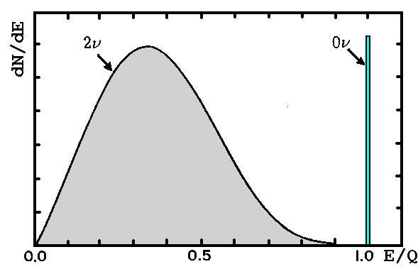
Goeppert-Mayer
decay process
(observed)
Racah & Furry
decay process
(expected)
A description of the same hypothetical process is just
creation of electrons in a nuclear transition
this emphasizes test of lepton number, clariﬁes the creation of matter components (=electrons), shows that it is as important as proton decay, suggests connections with cosmic origin of matter and can be explained to laymen.

Slide 34
Lepton
Quark
Quark
Quark
Quark
Lepton

Slide 35
fancy
Extensions of the SM, proton decay, Sakharov’ theoretical project, remarks on the baryon and lepton numbers in the SM, speculations on the origin of matter

Slide 36
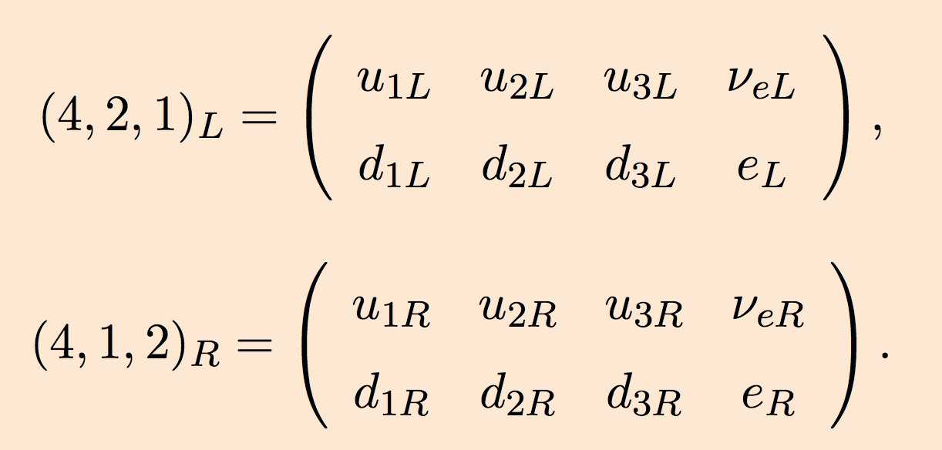
Extended Gauge Groups (GUT)
In SM, quarks are triplet of color, and leptons are singlets
In Pati-Salam SU(4)xSU(2)_{L}xSU(2)_{R} model leptons are the 4th color
SO(10) model 16=(4,2,1)+(4*,1,2) contains a whole family
In either groups, right handed neutrinos exists; ordinary neutrinos are massive; and other interesting things happen

Slide 37
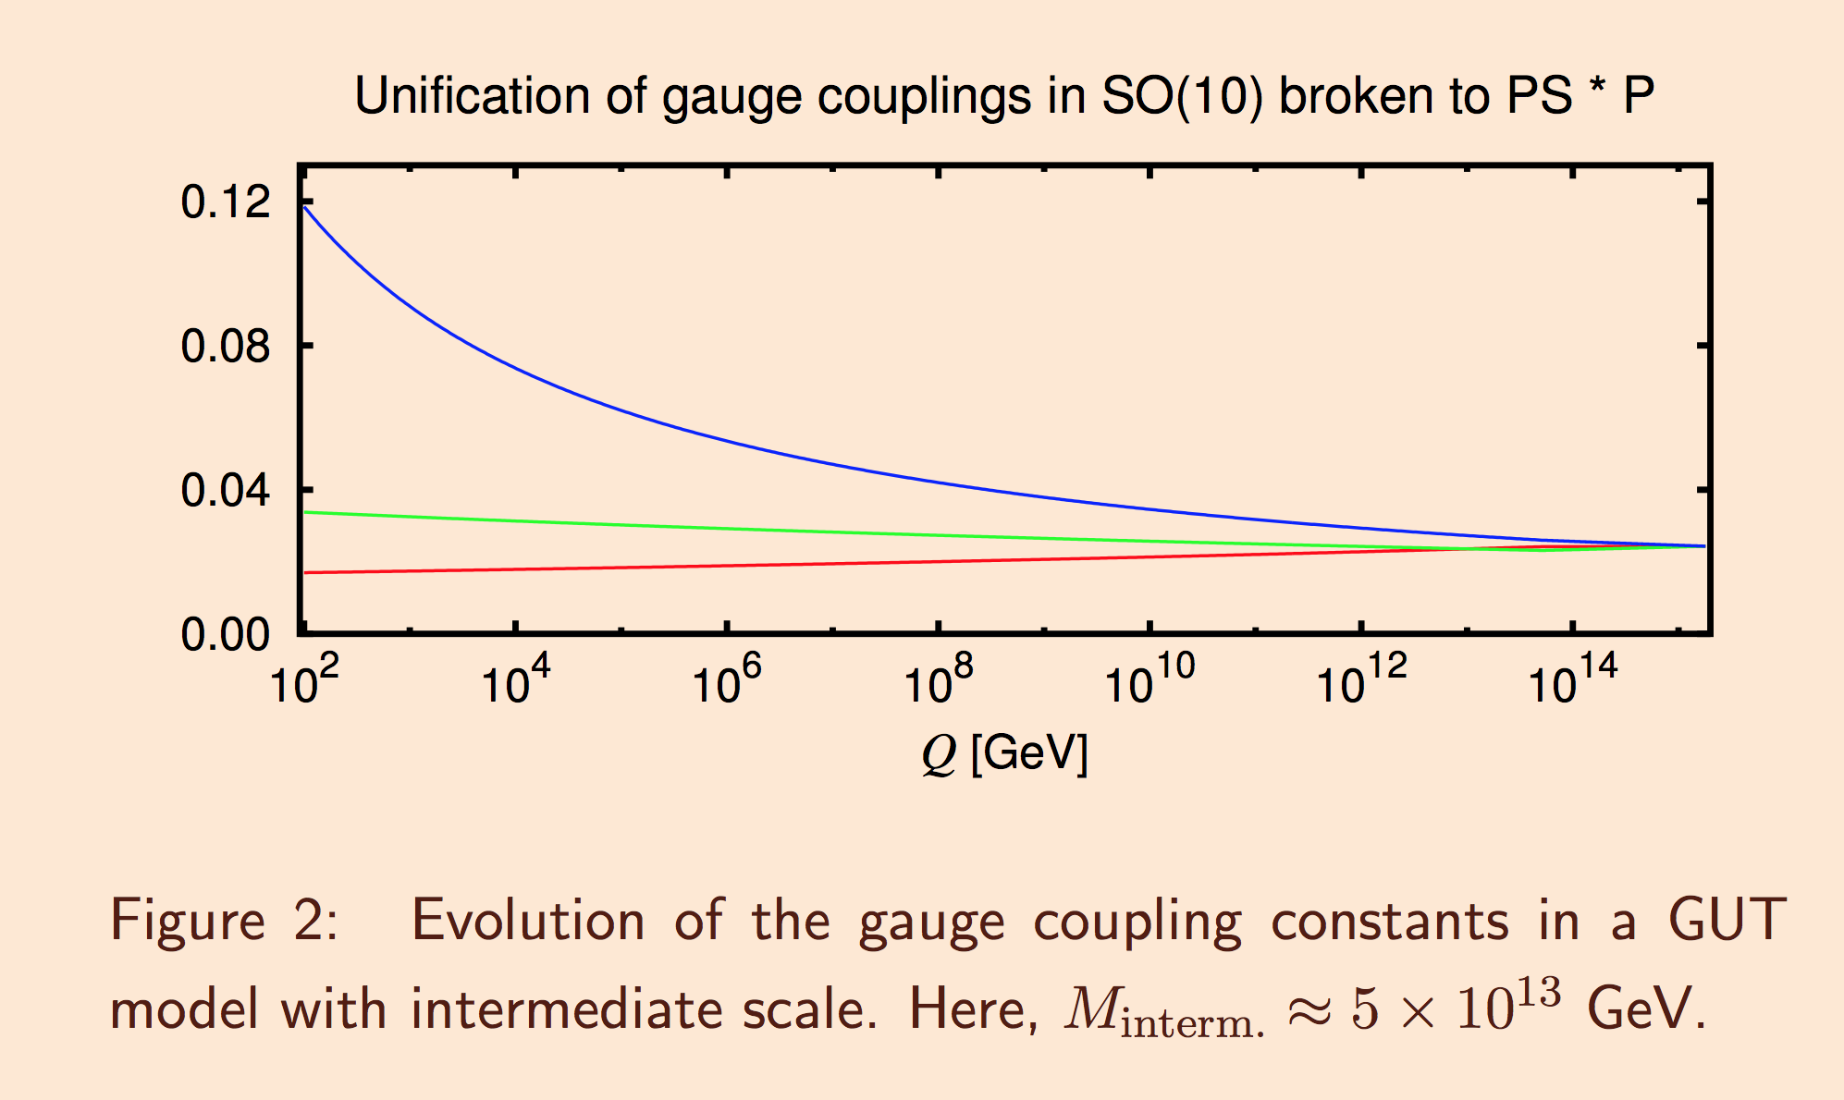

Slide 38
Quark
Quark
Anti
Lepton
Quark

Slide 39
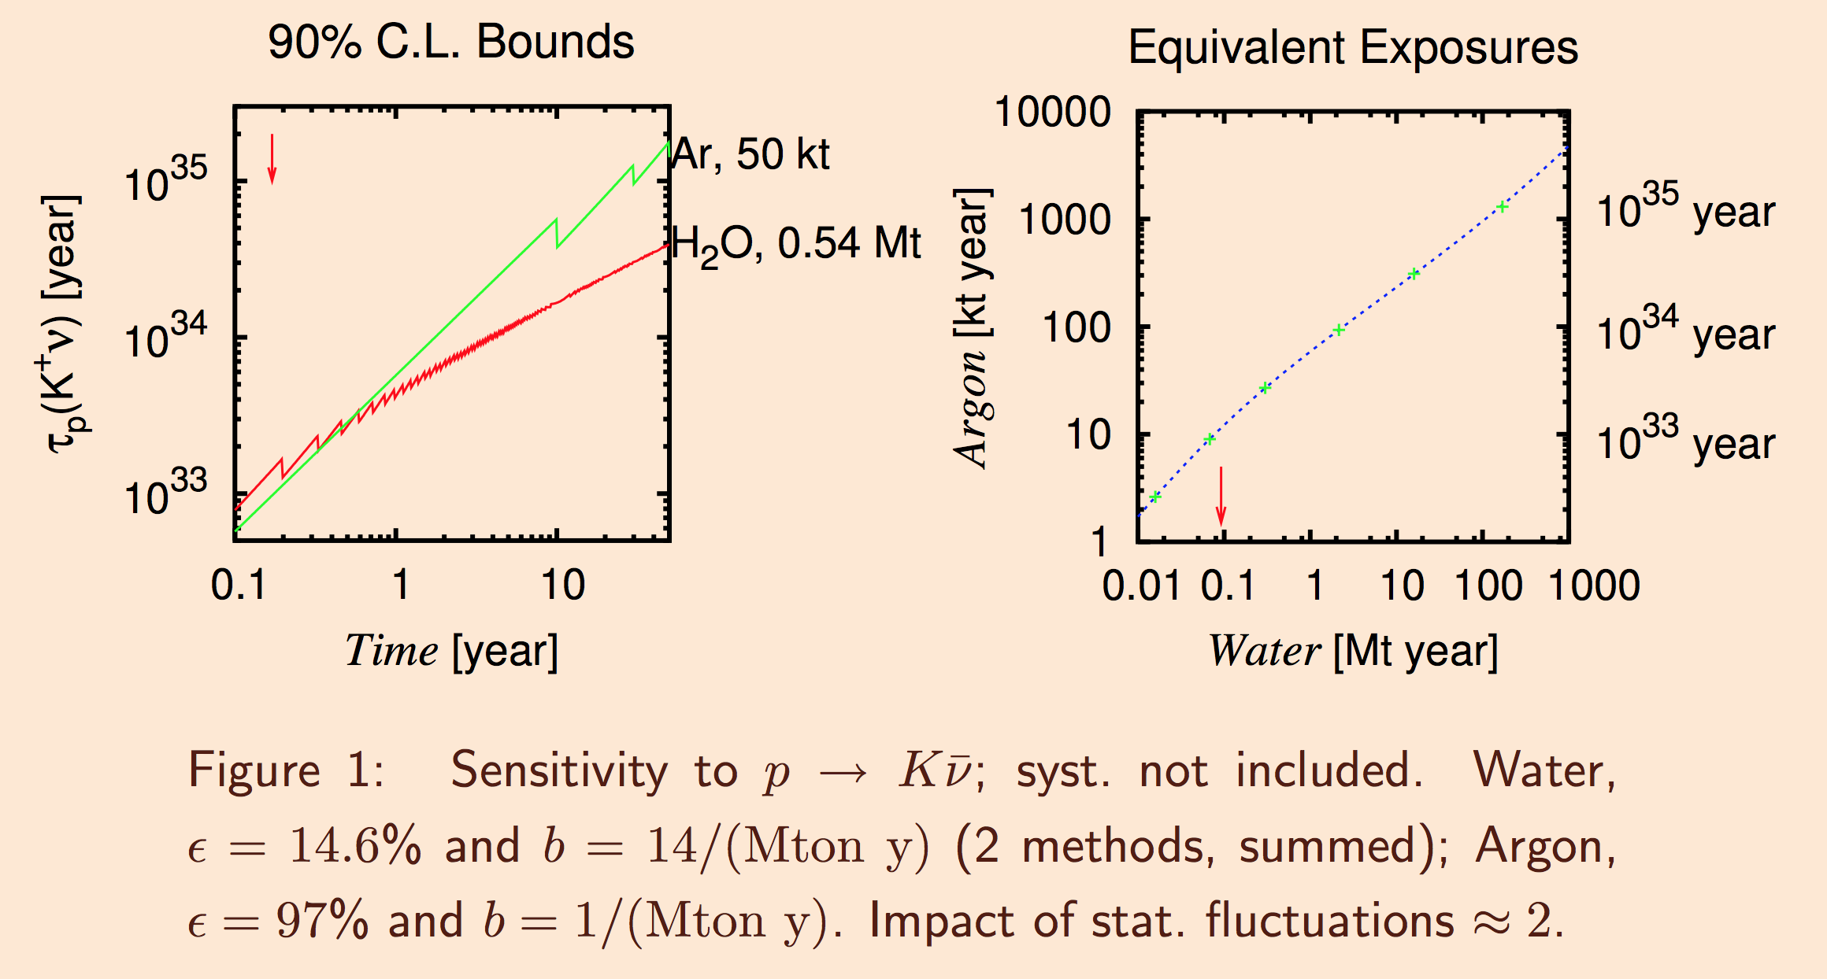

Slide 40
Sakharov ’67
In the early Universe, matter & antimatter annihilate
If we want to explain the predominance of matter
… we need baryon/lepton- violation

Slide 41
W ⁺
Neutrino
dJ^{μ}_{L} /dx^{μ}
Negative
lepton
Neutrino
W ⁻

Slide 42
Surprise surprise!
The SM does not respect the baryon and lepton number exactly, but only B-L
There are non-perturbative processes, where B and L are violated, effective at high energies
However, it was clarified that the SM alone is not able to implement Sakharov’s programme

Slide 43
With Fukugita & Yanagida ‘86
…neutrino masses enter the stage

Slide 44
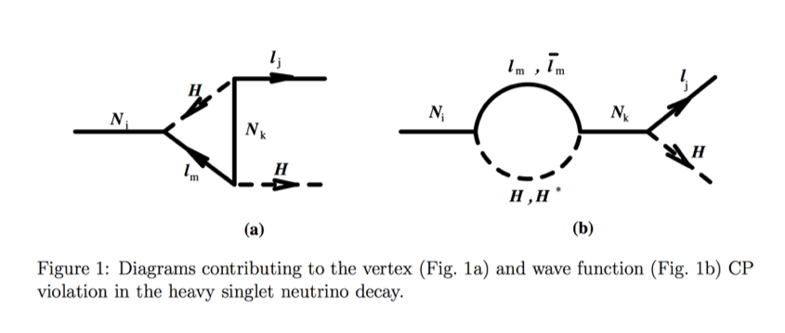
Covi et al. ‘96
The Heavy Right Neutrinos
can prefer to decay into antileptons, L<0; then, the SM effects
described previously convert part of this unbalanced L<0 into B>0

Slide 45
Discussion
The investigation of lepton and baryon numbers can be regarded as an entrance door to new physics
Majorana’s hypothesis on the nature of neutrino mass falls into this class: 0ν2β = creation of electrons
There are a few principles and ideas to build a convincing theory that extends the SM and explains fermion masses, but this goal is still to be achieved

Slide 46
spare slides
Mnemonic for left-right connection, double beta decay, heavy neutrinos, other operators for nucleon decay

Slide 47
−
L_{mass}= - λ H q_{R} q_{L}
Quark left
Higgs
Antiquark right

Slide 48
Adding a new `heavy’ neutrino

Slide 49
Higgs
boson
Quark
Quark
Quark
Lepton

